Slide 1
SO, YOU WANT TO GET OUT OF WISCONSIN?
TIPS, TRENDS AND PITFALLS FOR STATE INCOME TAXATION OF TRUSTS
Fox Valley Estate Planning Council
May 9, 2024

Slide 2
Topics
Fiduciary Income Tax Basics
State Taxation of Trusts
Constitutionality of State Trust Taxation
Pitfalls - Challenges to State Taxation of Trusts
Tips and Trends – What are we Seeing out There?
Questions

Slide 3
Fiduciary Income Tax Basics
Types of Trusts
Non-Grantor Trust
Separate taxpayer, but may pass through income to beneficiar(ies)
Simple Trust: Trustee is required to distribute all of the trust income to the beneficiary or beneficiaries on an annual basis
Complex Trust: Trustee has discretion to distribute all or a portion of its income to the beneficiary or beneficiaries
Grantor Trust
Ignored for income tax purposes
All of the income, deductions and credits are reported on the Grantor’s income tax return
Transactions between a Grantor Trust and the Grantor have no income tax effect

Slide 4
Fiduciary Income Tax Basics
Income taxed to Trusts generally have higher income tax liability
Exceptions include qualified dividend income and capital gains
Individuals (Single Filer) |  | Trusts
Income | Rate | Income | Rate
0 - $11,000 | 10%
$11,001 - $44,725 | 12% | 0 - $2,900 | 10%
$44,726 - $95,375 | 22% | $2,901 - $10,550 | 24%
$95,376 - $182,100 | 24% | $10,551 - $14,450 | 35%
$182,101 - $231,250 | 32% | $14,451 + | 37%
$231,251 - $578,125 | 35%
$578,126 + | 37%

Slide 5
Fiduciary Income Tax Basics
State income taxes can add significantly to the overall taxation of irrevocable, non-grantor trusts:
There are currently 8 states with no personal income tax – Alaska, Florida, Nevada, South Dakota, Tennessee, Texas, Washington, and Wyoming.
Top 10 Highest Income Tax States
State | Rate
California | 13.3%
Hawaii | 11.00%
New Jersey | 10.75%
Oregon | 9.90%
Minnesota | 9.85%
District of Columbia | 8.95%
New York | 8.82%
Vermont | 8.75%
Iowa | 8.53%
Wisconsin | 7.65%

Slide 6
Fiduciary Income Tax Basics
Distributable Net Income (DNI)
Trusts receive a deduction from taxable income for the amount of income that is distributed to a beneficiary. So either the Trust pays tax on the income, or the beneficiary does.
A beneficiary who receives income from a Trust will receive a Schedule K-1 from the Trust that lists the amount of income that must be reported by the beneficiary on his or her individual income tax return

Slide 7
State Taxation of Trusts
States that impose an income tax on trusts generally do so by characterizing a trust as a “resident” trust based on “nexus”
Primary factors under which a state may consider a trust to have nexus with the applicable state, and accordingly subject the trust to income taxation, include:
Trust was created by a resident of the state;
Trust is administered in the state;
Trustee resides in the state; and/or
Beneficiary resides in the state
Richard W. Nenno’s article dated February 28, 2019 entitled “Bases of State Income Taxation of Non-Grantor Trusts” has a summary chart showing the tax nexus for each of the states. Mr. Nenno had been updating that chart each year for the American College of Trust and Estate Counsel, who produces a PDF version of the chart.

Slide 8
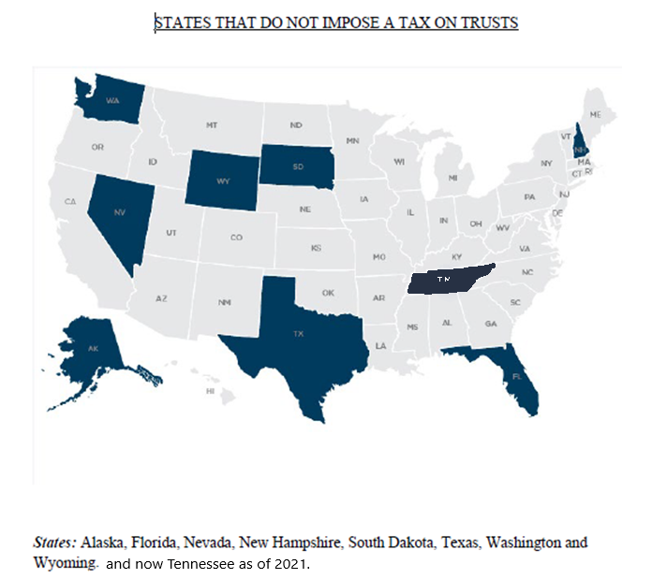

Slide 9
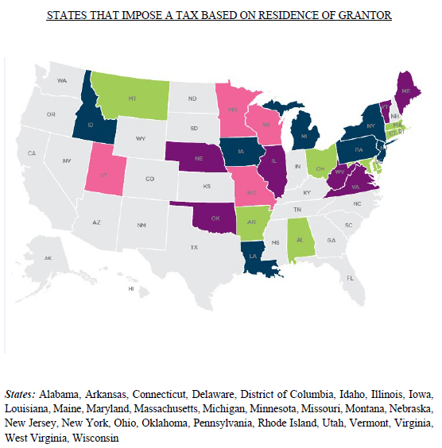
Purple: If the grantor of the trust was a resident of the state, or if the trust was created by testamentary devise and the testator was a resident of the state, then the trust is subject to income tax.
Green: If the grantor of the trust was a resident of the state, or if the trust was created by testamentary devise and the testator was a resident of the state, and the trust has either (i) a resident fiduciary (AL, AR) or (ii) a resident beneficiary (AL, DE, MD, MA, RI), then the trust is subject to income tax.
Michigan does not tax inter vivos trusts created by a resident if the trustee, beneficiary and administration occur outside of the state.
Connecticut and Ohio apply to inter vivos trusts with resident beneficiaries.
Blue: If the grantor of the trust was a resident of the state, or if the trust was created by testamentary devise and the testator was a resident of the state, and other requirements are satisfied, then the trust is subject to income tax.
Louisiana tax based on the residence of the grantor for testamentary trusts only.
Pink: Tax only certain trusts based on date of creation.
Minnesota taxes only trusts created after 1995.
Missouri taxes only trusts with a resident beneficiary on the last day of the tax year of the trust.
Utah taxes only trusts under Will and inter vivos trusts created before 2003.
Wisconsin only taxes trusts that became irrevocable on or after October 29, 1999 or are pre-1999 and administered in WI

Slide 10
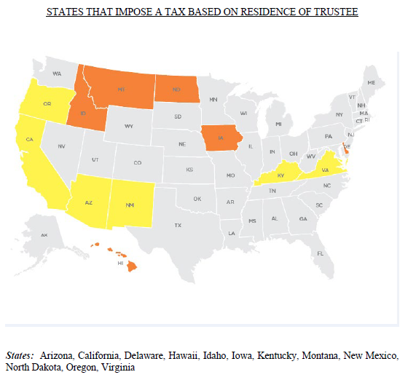
Yellow: If the trustee is a resident of the state, the trust is subject to income tax.
Orange: If the trustee is a resident of the state and other requirements are satisfied (for example, a beneficiary of trust also is resident of the state (DE and HI)), then the trust is subject to income tax.

Slide 11
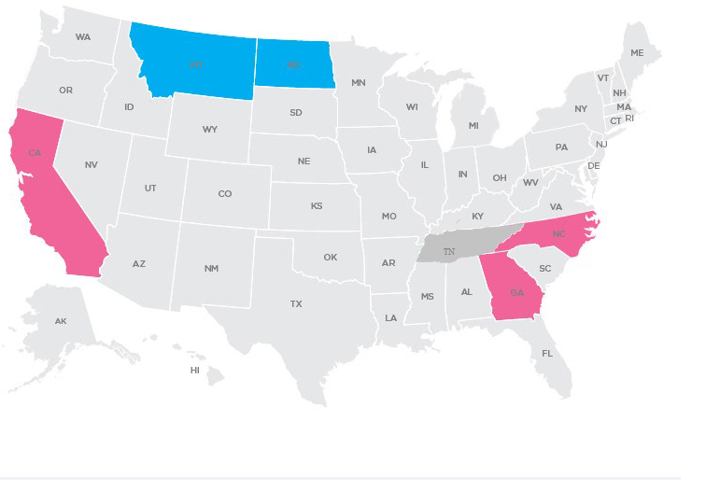
STATES THAT IMPOSE A TAX BASED ON RESIDENCE OF BENEFICIARY
States California, Georgia, Montana, North Carolina, and North Dakota (states in aqua require additional factors)

Slide 12
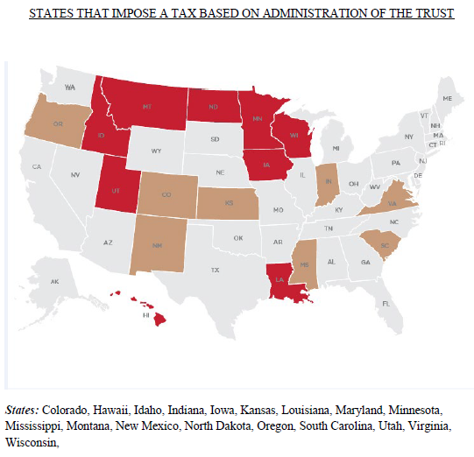
Brown: If the trust is administered in the state, the trust is subject to income tax.
Red: Only if other factors apply or only certain trusts based on date of creation.
If the trust is administered in the state and other requirements are satisfied (for example, a beneficiary of trust also is resident of the state (HI) or the trust provides for governing law of state (LA)), then the trust is subject to income tax.
Minnesota taxes only trusts created before 1996.
Utah taxes only trusts under Will and inter vivos trusts created before 2003.
Wisconsin taxes inter vivos trusts administered in state before October 29, 1999.

Slide 13
State Taxation of Trusts
Keep in mind that grantor trusts will always end up paying state income tax based on the grantor’s domicile for state tax purposes
Keep in mind that non-grantor trusts who distribute all of their income will cause the beneficiary to pay state income tax based on the beneficiary’s domicile for state tax purposes
Keep in mind that source income in a given state will always be taxed in that state

Slide 14
State Taxation of Trusts
Starting Point – the Trust Agreement
Typical Choice of Law Provision(s):

Slide 15
State Taxation of Trusts
Typical Trustee Power regarding Situs:

Slide 16
State Taxation of Trusts
Wis. Stat. § 71.14(1): Estate of a decedent shall be considered resident at the domicile of the decedent at the time of the decedent’s death
Wis. Stat. § 71.14(2): Testamentary Trust created by a decedent who at the time of death was a resident of Wisconsin shall be considered resident at the domicile of the decedent at the time of the decedent's death until transferred by the court
Wis. Stat. § 71.14(3): Irrevocable Trusts administered in Wisconsin before October 29, 1999 shall be considered resident at the place where the Trust is being administered
Wis. Stat. § 71:14(3m): Wisconsin resident Trust if the Trust was funded by a Wisconsin resident and either:
Became irrevocable on or after October 29, 1999, or
Became irrevocable before October 29, 1999 and is administered in Wisconsin on or after October 29, 1999

Slide 17
Constitutionality of State Trust Taxation
The U.S. Supreme Court has addressed the issue of the constitutionality of the states to tax taxpayers under two clauses of the U.S. Constitution – the Due Process Clause the Commerce Clause. Under both, the state must show some nexus between the taxpayer and the state imposing the tax.
Due Process Clause
“No State shall make or enforce any law which shall … deprive any person of life, liberty, or property, without due process of law.”
Quill Corp. v. North Dakota (1992): “The Due Process Clause requires (1) some definite link, some minimum connection, between a State and the person, property or transaction it seeks to tax, and (2) that the income attributed to the State for tax purposes must be rationally related to values connected with the taxing State … [w]e have framed the relevant inquiry as whether a defendant had minimum contacts with the jurisdiction such that the maintenance of the suit does not offend traditional notions of fair play and substantial justice.”
Ask whether an individual’s connections with a state are substantial enough to legitimate the state’s exercise of power over such individual.
Analysis of “notice” or “fair warning” to the taxpayer

Slide 18
Constitutionality of State Trust Taxation
Commerce Clause
The statute must satisfy the following requirements:
The taxpayer must have a substantial nexus to the taxing jurisdiction;
The tax must be fairly apportioned;
The tax must be fairly related to the benefits being conferred by the taxing jurisdiction; and
The tax must not discriminate against interstate commerce.
More stringent than due process analysis because focus is on structural concerns about the effect of state regulation on the national economy
Goal to prevent discrimination against interstate commerce and prevent burdens on interstate commerce that are excessive in relation to supposed local benefits
Wayfair held that “substantial nexus” does not require physical presence

Slide 19
Constitutionality of State Trust Taxation: Grantor Residency
Although a nongrantor trust is a separate taxpayer, it is not the equivalent of an entity for state law purposes. A trust is created by virtue of a relationship between a trustee and the beneficiaries, created by a grantor. Once created, the grantor, in that sole capacity, has no actual activity with regard to the trust or its administration. Thus, basing taxation of a trust solely on the state of residence of a grantor seems insufficient to meet the Commerce Clause standard. However, several cases have found statutes taxing a trust on the basis of the state of residence of the grantor as constitutional.
District of Columbia v. Chase Manhattan Bank, 689 A2d 539 (DC, 1997) – Trust created under Will of resident decedent, subject to taxation in District of Columbia, despite non-resident trustee and beneficiary.
Chase Manhattan Bank v. Gavin, 733 A2d 782 (CT, 1999) – Inter vivos trust created by Connecticut resident held resident trust under Connecticut statute.

Slide 20
Constitutionality of State Trust Taxation: Grantor Residency
In more recent years, however, there have been a number of high profile cases where Courts have been siding with the taxpayer:
Residuary Trust A v. Director, 27 NJ Tax 68 (Tax Ct., 2013) - Residency of grantor of testamentary trust in New Jersey insufficient to permit taxation in New Jersey under Due Process analysis.
Linn v. Department of Revenue, 2 NE2d 1203 (ILL App, 2013) – Grantor of inter vivos trust domiciled in Illinois insufficient to support taxation of trust in Illinois under Due Process Clause.
William Fielding v. Commissioner of Revenue of State of Minnesota (MN, 2018) – Four trusts created by a Minnesota resident and funded with stock in a Minnesota closely held business did not have sufficient nexus with Minnesota to be considered resident trusts.

Slide 21
Fielding v. Commissioner of Revenue, 916 N.W. 2d 323 (Minn. 2018)
Minnesota Statute
Resident Trust defined as an irrevocable trust, the grantor of which was domiciled in Minnesota at the time it became irrevocable
Facts
In 2009, Minnesota resident created four inter vivos irrevocable grantor Trusts for the benefit of his children and funded the Trusts with non-voting stock in a Minnesota S Corporation (grantor Trust until December 31, 2011)
Location of Trustee: California, Colorado and Texas, respectively
Location of Beneficiaries: California, New York (2) and Minnesota
Governing Law: Minnesota
In 2014, the Trustee sold shares of the Minnesota S Corporation
The Trustee filed Minnesota income tax returns in 2014 under protest and sought refunds for the tax paid

Slide 22
Fielding v. Commissioner of Revenue, 916 N.W. 2d 323 (Minn. 2018)
Minnesota Supreme Court (4-2)
The Minnesota statute, as applied, was unconstitutional because the Trustee did not have sufficient contact with Minnesota to satisfy due process requirements
Court must analyze the connections between the Trust and Minnesota and whether the income that Minnesota seeks to tax is rationally related to the benefits being conferred on the Trust by Minnesota
Only relevant connections are those of Trustee (i.e., location of Trustee, Trustee’s decisions, Trust administration activities, and Trust records, existing relationship with Minnesota Courts)
Due process contacts must be evaluated year by year
Choice of law irrelevant
Domicile of the Grantor at the time of a Trust’s creation alone was not a sufficient basis to permit Minnesota to tax all of the income of the Trust for the year in issue
U.S. Supreme Court denied cert on June 28, 2019

Slide 23
Constitutionality of State Trust Taxation: Beneficiary Residency
Only 5 states use the residence of a beneficiary of a trust in the determination that the trust is a “resident” trust. As a separate taxpayer, whose activities are viewed through its trustee, not beneficiary, taxation based on residence of the beneficiary would seem to be the least supported by the tenants of the Due Process and Commerce Clauses. Accordingly, several of these states, including
McNeill v. Commonwealth, 67 A3d 185 (PA, 2013) – Beneficiary domiciled in Pennsylvania was insufficient, alone, to satisfy the Commerce Clause requirements to substantiate the taxation of the trust in Pennsylvania.
Chase Manhattan Bank v. Gavin, 733 A2d 782 (CT, 1999) – Beneficiary resident of Connecticut insufficient to support taxation under the Due Process and Commerce Clauses.
Kimberly Rice Kaestner v. North Carolina Department of Revenue 588 U.S. ___ (2019) (NC, 2018) – presence of in-state beneficiaries alone does not empower a State to tax trust income that has not been distributed to the beneficiaries where the beneficiaries have no right to demand that income and are uncertain to ever receive it

Slide 24
North Carolina Dept. of Rev. v. The Kimberley Rice Kaestner 1992 Family Trust, 588 U.S. ___ (2019)
North Carolina Statute
Taxes trust income that is for the benefit of a resident of North Carolina
Facts
In 1992, New York resident created a Trust for his children. In 2002, the Trust was divided into separate shares and later segregated as separate Trusts in 2006.
Location of Trustee: New York, Connecticut
Location of Beneficiary: North Carolina
Custody of Assets: Massachusetts
Governing Law and Administrative Activities: New York
Distribution Standard: Trustee absolute discretion
No distributions to beneficiary in years in questions; one loan was made and repaid
The Trustee filed North Carolina income tax returns under protest and sought refunds for the tax paid

Slide 25
North Carolina Dept. of Rev. v. The Kimberley Rice Kaestner 1992 Family Trust, 588 U.S. ___ (2019)
U.S. Supreme Court (9-0)
The North Carolina statute, as applied, was unconstitutional because the Trustee did not have sufficient contact with North Carolina to satisfy due process requirements
Court must inquire into what exactly the beneficiary controls or possesses and how that interest relates to the object of the State’s tax
The presence of in-state beneficiaries alone does not empower a State to tax trust income that has not been distributed to the beneficiaries where the beneficiaries have no right to demand that income and are uncertain to ever receive it
A taxed entity’s minimum contacts with the taxing state cannot be established by a third party’s (i.e., the beneficiary’s) minimum contacts
As a separate legal entity in the context of taxation, the Trust would have needed to purposefully avail itself of the benefits and protections offered by the State
Only the Trustee’s actions can provide the minimum contacts necessary under Quill
Holding limited to the specific facts presented and does not imply approval or disapproval of trust taxes that are premised on different factual circumstances

Slide 26
Pitfalls - Challenges to State Taxation of Trusts
Procedural Options
Do Nothing - Continue to file and pay taxes
Stop filing state returns (make sure to file “final” return in relevant state)
File annual “zero” returns
Retain source income and file non-resident return
Pay taxes and seek refund
Considerations
Precedential or persuasive case law regarding local tax at issue
Amount of tax at stake, applicable interest and penalties
Other “contacts” in state
Beneficiaries’ appetite for uncertainty and risk
Trustees’ liability/indemnification standard

Slide 27
Pitfalls - Challenges to State Taxation of Trusts
What could go wrong?
Wis. Stat. § 71.82(1)(a): In assessing taxes interest shall be added to such taxes at 12 percent per year from the date on which such taxes if originally assessed would have become delinquent if unpaid, to the date on which such taxes when subsequently assessed will become delinquent if unpaid.
Wis. Stat. § 71.83(1)(a)(1): In case of failure to file any return required under s. 71.03, 71.24, 71.44, or 71.775 on the due date prescribed therefor, including any applicable extension of time for filing, and upon a showing by the department under s. 73.16 (4), there shall be added to the amount required to be shown as tax on the return 5 percent of the amount of the tax if the failure is for not more than one month, with an additional 5 percent for each additional month or fraction thereof during which the failure continues, not exceeding 25 percent in the aggregate.
Wis. Stat. § 71.83(1)(b)(1): …any person making an incorrect, or failing to make a, report… to defeat or evade the income or franchise tax assessment required by law, shall have added to the tax an amount equal to 100 percent of the tax on the entire underpayment.

Slide 28
Pitfalls - Challenges to State Taxation of Trusts
Trustee Liability
If you outsource the fiduciary income tax returns for the Trust and the tax preparer takes the position, is the Trustee off the hook?
What if you do the fiduciary income tax returns in house?

Slide 29
Tips and Trends – What are we Seeing out There?
Pre-1999 Wisconsin Trusts
Since they are only taxed in Wisconsin if they are being administered in Wisconsin, if you can move the administration out of state you can eliminate Wisconsin state income tax.
Options to “administer” out of state – depends on whether you are state-chartered or hold a national charter
What happens if you have a pre-1999 pot trust and it divides after 1999? What date do you use for the new sub-trusts for purposes of the Wisconsin Statutes?

Slide 30
Tips and Trends – What are we Seeing out There?
What about Grantor Trusts?
Grantor Trusts can avoid state income taxation if the Grantor moves to a non-taxable state
What happens if the Grantor wants to turn off the Grantor Trust status or dies eliminating Grantor Trust status?
Wisconsin: Wisconsin resident Trust if the Trust was funded by a Wisconsin resident and became irrevocable on or after October 29, 1999
Illinois: Resident means an irrevocable trust, whose grantor was domiciled in Illinois at the time the trust became irrevocable. For purposes of this definition, a trust is irrevocable to the extent that the grantor is not treated as the owner of the trust under IRC Sections 671 through 678.
So there are interesting opportunities depending upon whether the Grantor is willing to retain Grantor Trust status or based on state law.

Slide 31
Tips and Trends – What are we Seeing out There?
What about Decanting?
Example – you have a 2010 Irrevocable Trust established by a grantor who was domiciled in WI in 2010, but now has moved domicile to Florida. What if the grantor sets up a 2023 Irrevocable Trust while a resident of Florida that is identical to the 2010 Trust and then the Trustee decants the 2010 Trust into the 2023 Trust?

Slide 32
Tips and Trends – What are we Seeing out There?
Post-1999 Wisconsin Trusts?
What do we do with these if the grantor is still domiciled in Wisconsin?
Anyone want to be the test case to challenge the constitutionality of Wisconsin’s law basing nexus on the residency of the grantor?

Slide 33
Tips and Trends – What are we Seeing out There?
Opportunities for Out of State Trusts?
California (13.3%) - Unlike income taxation of trusts in many other states, the taxability of non-California source income retained by a trust depends only on the residence of the fiduciaries and non-contingent beneficiaries. In California, the residency of the grantor and contingent beneficiaries’ is irrelevant.
State of California FTB Technical Advice memorandum 2006-0002, addresses the definition of a “contingent interest”:
“A resident beneficiary whose interest in a trust is subject to the sole and absolute discretion of the Trustee holds a contingent interest in the trust. The exercise of the Trustee’s discretionary power is a condition precedent that must occur before the beneficiary obtains a vested interest in the trust.”
“This technical advice memorandum presumes the trustee has complete, unfettered discretion whether and when to make a distribution. However, the trust document should be reviewed in each case to determine any limitations on the trustee's discretion to accumulate income rather than to distribute it to the beneficiary.”

Slide 34
Tips and Trends – What are we Seeing out There?
Opportunities for Out of State Trusts?
Assuming you have a California Trust with a Wisconsin Trustee and either no CA beneficiaries or only CA beneficiaries with a contingent interest does Wisconsin subject that trust to tax?
Similarly, what if you have a trust set up in a non-tax state (Alaska, Florida, Nevada, New Hampshire, South Dakota, Tennessee, Texas, Washington, and Wyoming) and you have a WI Trustee?
What about an Illinois Irrevocable Trust that was set up by a grantor who was domiciled in Illinois at the time that Trust became irrevocable, but now you have a Wisconsin Trustee?
In other words, do NOT assume that every trust you administer will be subject to state income tax, as the myriad of state tax laws has created a number of situations where trusts have no state filing requirements.

Slide 35
Questions?

Slide 36
Jeff Billings
Estate Planning Team Shareholder
and Market Leader
(414) 287-9615
jbillings@gklaw.com

