Slide 1
Charitable Remainder Trusts and Retirement Assets After the SECURE Act
Presented by: Atty. Mark D. Munson, Ruder Ware, L.L.S.C.
for the
Fox Valley Estate Planning Council
November 11, 2022

Slide 2
Mission of this session
The applicable distribution period (the “ADP”) for most beneficiaries of inherited retirement benefits was shortened to only ten years by the SECURE Act.
Life expectancy distribution periods are no longer available, except for “eligible designated beneficiaries” (or “EDBs”) and “applicable multiple-beneficiary trusts” (or “AMBTs”).
In this session, charitable remainder trusts (or “CRTs”) will be discussed as a means to increase the length of the distribution period when the life expectancy distribution period is not otherwise available for the client who would prefer a trust as the beneficiary of a retirement asset instead of an individual and is also charitably inclined.

Slide 3
Fact Pattern
Your client, Jane Doe, a widow and age 83, wants to leave money equally to her three children, who are Joseph Doe (50), Janet Doe (48), and Jake Doe (45). Joseph is not disabled as determined by the Social Security Administration (not for a lack of trying, however). Joseph has some learning disabilities, communication impairments, is socially challenged, and is economically challenged. Joseph lives with Jane and she is primary caretaker, social outlet, and “protector.” Jane considers Joseph to be a “vulnerable” adult. Jane’s other two children are married, have children, and are independent. She has a wonderful relationship with all three of her children.
Jane and her deceased husband (John Doe) worked very hard over the years, have done quite well for themselves, and she now has a $3M IRA along with other assets and a considerable inheritance from her parents. Her primary objective with her estate planning is treat all of her children equally, but she wants Joseph’s share to go “in trust” for Joseph’s benefit with a third-party professional trustee.
What is the best way for Jane to leave her IRA to Joseph? We will explore possible options, answers, and solutions to that question in this session?

Slide 4
Types of Charitable Trusts
Charitable Remainder Annuity Trusts or CRATs;
Charitable Remainder Unitrusts or CRUTs;
Charitable Lead Annuity Trusts or CLATs; and
Charitable Lead Unitrusts or CLUTs.

Slide 5
Split Interest Gifts
A split interest gift is when the income from the gift goes to one place, and the principal of the gift goes somewhere else.
For example, the income may go to you, your heirs, or the charity, and then after a certain period of time (or, after a certain event, such as death) the principal goes to your heirs or the charity.
Thus, the income and the principal are “split.” This splitting of the interest is what allows for all kinds of interesting benefits you may be interested in.

Slide 6
Unitrusts vs Annuity Trusts
The UT in the acronyms stands for “UniTrust.” The AT stands for “Annuity Trust.”
With a Unitrust, the income payments vary with how well the investments in the trust are doing. If the investments are doing well, the payments are high and vice versa.
With an Annuity Trust, the payments are fixed, no matter how the investments are doing.
Annuity payments are based on a percentage of the ORIGINAL amount in the trust. Unitrust payments are based on a percentage of the CURRENT amount in the trust.
If you think the investments in the trust will do well, go with a unitrust. If you have less faith in them, use an annuity trust.

Slide 7
Lead Versus Remainder
The “C” in all these acronyms stands for “Charitable.”
The “L” stands for “Lead” and the “R” stands for “Remainder.”
This refers to what the charity gets. If the charity gets the income, it's a charitable lead trust.
If the charity gets the principal, it's a charitable remainder trust.
In times of high interest rates, remainder trusts are better for the “donor” since she gets paid a higher rate.
In times of low interest rates, lead trusts are better for the “donor’s” heirs, since the charity gets paid at a lower rate.
The “donor” is the individual who creates or settles the charitable trust, who is sometimes referred as the settlor, grantor, or trust creator.

Slide 8
CRATs and CRUTs – An traditional example
A charitable remainder annuity trust (or, “CRAT”) may not require you to be all that charitable in order to work out well. Consider John and Jane Doe, both 75 years old, who have a 23.8% capital gains income tax rate (between federal and Wisconsin), a 43% marginal income tax rate (between federal and Wisconsin), and $500,000 in appreciated stock with a basis of just $100,000 (for a $400,000 unrealized capital gain). If they decided to use a joint lifetime CRAT, it could pay them $34,768.45 per year. They would get a charitable donation deduction of $132,490.53, potentially saving them $56,971 in income taxes. They would also defer $95,200 in capital gains taxes over the term of the CRAT. So, here's what they get:
A smaller estate, possibly reducing estate taxes (if they have a taxable estate)
The ability to eliminate investment risk/rebalance without incurring immediate capital gain income taxes (imagine if the donation didn't consist of the shares of a broadly diversified index fund, but rather $500,000 of shares in a single company)
$95,200 deferral in capital gain income taxes over 10 yrs without having to pay any interest
Charitable income tax deduction upon contribution of the appreciated asset to the CRAT

Slide 9
CRATs and CRUTs – A traditional example (cont.)
$56,971 break in income taxes (limited to 30% of AGI for private foundations and 50% for churches, hospitals, schools, public charities, and government entities, but can be carried over for 5 years)
$34,768.45 per year for the rest of both of their lives
Good feelings from supporting their favorite charity or having a “charitable fund,” such as a “donor advised fund” sponsored by the local community foundation

Slide 10
CRATs and CRUTs – A traditional example (cont.)
Would they be better off just selling off the shares and buying an annuity?
Probably not in this case. If they sold the shares, they would lose the $132,490.53 charitable deduction plus have to pay immediately $95,200 in capital gains taxes, leaving just $404,800.
A joint annuity on two 75 year-olds pays 7.5%. Sure, that's more than the 6.95% the CRAT is paying, but keep in mind the CRAT is paying 6.95% on $500,000, not $404,800. In reality, the joint annuity would have to pay 8.4% to be as good as the CRAT.
See what I mean about not having to be very charitable for this to work out well? Keep in mind that given our very low interest rate environment, you may not be able to get one of these if you're too young due to IRS rules about the remainder going to the charity being at least 10% of the amount going into the trust.

Slide 11
CRATs and CRUTs – A traditional example (cont.)
If John and Jane decided to use a CRUT instead, they have to choose a withdrawal rate between 5% and 16.70345% (optimized).
What's the downside of choosing 16.70345%?
Well, with a higher rate they'll end up leaving less to charity. This is reflected in the size of their initial charitable donation deduction of just $50,005 ($21,500 off their taxes).
Also, if the trust isn't actually growing at a rate of 16.70345% or higher, their payments will actually go down over time. But they do get to at least start with a an annual payment of $83,517.24.
If they choose 5% instead, their annual payment will start at just $25,000, however the payments are far more likely to go up over time (or at least not go down as fast). Plus, they'll get a much larger initial charitable donation deduction, $236,365 ($101,637 off their taxes).

Slide 12
CLATs and CLUTs
Lead trusts can also be useful, especially in times of low interest rates (like they were not too long ago). They are particularly useful for reducing estate taxes owed. By giving annual payments to charity for a set period of time (rather than the rest of your life), you can give the principal to your heirs free of estate taxes. Typically, a term of between 5 and 25 years is selected and rates are typically between 5% and 15%. The longer the term and the higher the rate, the larger the charitable deduction (and the smaller the amount your heirs will get).
If John and Jane choose a CLAT with a rate of 5% ($25,000 per year) for 10 years, they will give the charity $250,000 total and will get a charitable donation deduction of $222,000. Whatever is left, goes to their heirs ($278,000 of which would be subject to wealth transfer taxes). If the trust made 8% a year for those 10 years, the heirs would get $672,000, the charity would get $250,000, John and Jane would save $100,000 in income taxes, and the IRS may not get anything. Even if the trust only made 5%, the heirs would still get $500,000.

Slide 13
CRATs and CLUTs
If they chose to use a CLUT instead, with the same 5% rate and 10 year term, the deduction would be smaller, just $197,000 ($89,000 off their income taxes). The better the investments do, the more the charity gets each year and the more your heirs get in the end. The worse the investments do, the less the charity gets each year and the less your heirs get in the end.

Slide 14
CRATs and CRUTs
You can even combine a charitable gift with a spendthrift trust. Upon your death, your money goes into a charitable trust. The money is out of the estate (avoiding estate taxes) and a certain amount of it (depending on the age of the spendthrift and current interest rates) is a deduction on the estate's income taxes that year. The spendthrift gets an annuity payment every year for the rest of his life. You can even set it up so the spendthrift heir gets to pick the charity.

Slide 15
Charitable Remainder Trusts
A charitable remainder trust (CRT) is just like any other trust – it has a “trust settlor” (or “trust grantor” or “trust creator”) who establishes and funds the trust, a fiduciary administering the trust (the “trustee”), and beneficiaries receiving income from the trust and remaining trust assets at the time the trust terminates.
As in the case of any other trust, the arrangement between the three parties is memorialized in a trust agreement. The key differences between a CRT and other trusts are as follows:
(1) a CRT is a tax-exempt entity;
(2) the trust “remainder” beneficiaries must be qualified charities;
(3) the income beneficiaries of a CRT must include a non-charitable beneficiary; and
(4) the person funding the trust (i.e., the settlor) is entitled to claim an income tax deduction in the tax year that the CRT is funded.

Slide 16
Basic Rules of CRTs
All CRTs share the following characteristics:
At least one non-charitable income beneficiary;
Income payout must be at least 5 percent, but no more than 50 percent;
Payout is set based on the value of trust assets either as valued when the trust is funded (in the case of an “annuity” trust), or as assets are revalued annually (in the case of a “unitrust”);
Trust term (how long the trust will last) can be no more than 20 years, for the lifetime(s) of a measuring life(s), or a combination of a lifetime(s) and a term of years not to exceed 20; and
Remainder beneficiary(ies) of the CRT must be a qualified 501(c)(3) charity.
CRTs are tax-exempt
Non-charitable income beneficiaries of the CRT are subject to tax on distributions from the CRT in the year the distribution(s) is received.

Slide 17
CRAT or CRUT?
Charitable remainder trusts can be structured in numerous ways. The two basic categories are charitable remainder annuity trusts (CRATs) and charitable remainder unitrusts (CRUTs).
The primary difference between the two basic categories is how the income payment is calculated. In the case of a CRAT, the payment is based on the value of assets transferred to the CRAT at the time the CRAT is funded. For a CRUT, the annual payment from the unitrust varies from year to year, and is calculated using the value of the assets held by the trust as those assets are re-valued on an annual basis.
For example, if you transfer $500,000 of stock to a CRAT with a 5% annual payout, the annual income payment from the CRAT will be $25,000 every year of the CRAT’s existence.
Alternatively, if you donate assets valued at $500,000 to a 5% payout CRUT on January 1, the income beneficiary would receive $25,000 during the first year of the CRUT. If the value of the CRUT assets are $510,000 the following year, the income beneficiary would receive $25,500. Conversely, if the following year the CRUT assets are worth $450,000 on the annual valuation date, the income beneficiary payment drops to $22,500.

Slide 18
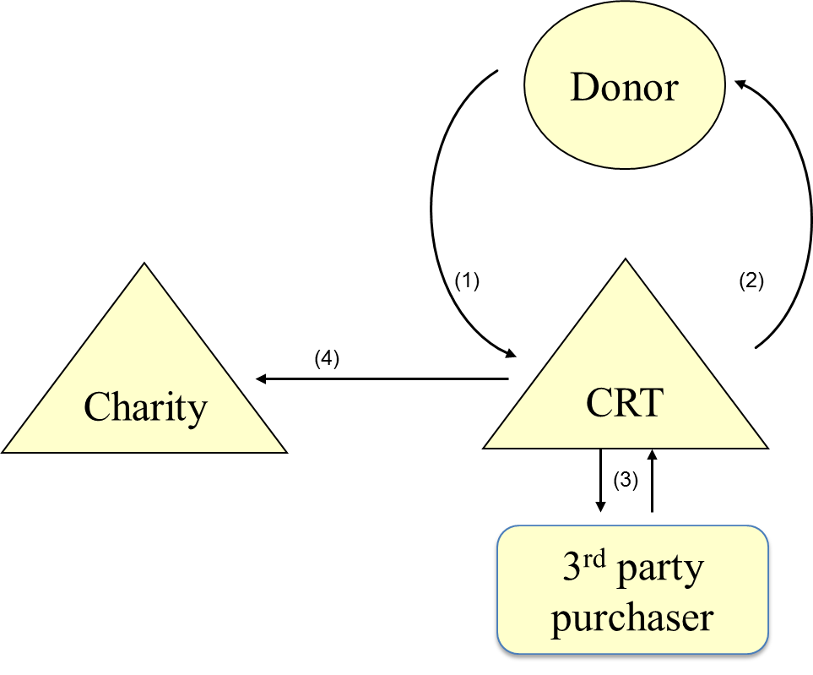
CRT Illustrated

Slide 19
Result of Implementing a CRT
The following table illustrates one possible result from implementing a CRT (structured as a CRUT).
The table compares the result of implementing a 20-year term CRUT paying 5% per year, funded with stock valued at $500,000, purchased for $250,000 ten years ago (long-term capital gain property) and sold by the CRUT upon receipt versus an outright sale of the stock.
In both cases, the assumption is that the net sales proceeds are re-invested in a portfolio that appreciates at 7% per year, yields 1% annually, and is subject to 10% turn-over each year.
Additional assumptions are found at the bottom of the table.

Slide 20
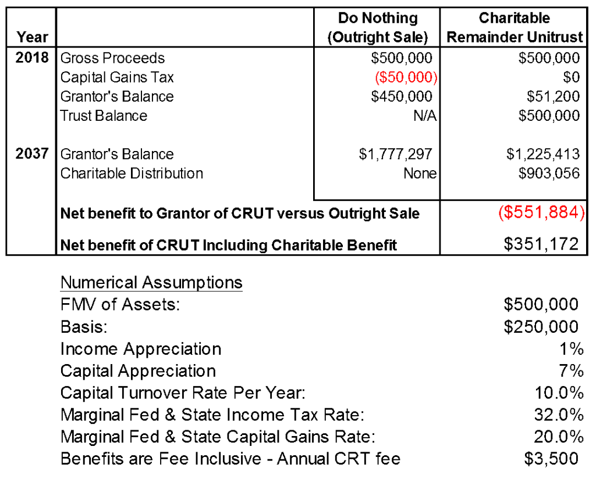
CRUT Example

Slide 21
CRATs and CRUTs
As calculated using the described assumptions, while a philanthropist would accumulate $1,777,297 over a twenty year period if they simply sold the stock and reinvested the net, after tax proceeds, the total amount returned through implementation of a CRUT is $2,128,469 – an increased return of $351,172.
In the case of the CRUT, the total return is split between the philanthropist and the charitable remainder beneficiaries – $1,225,413 to the philanthropist, $903,506 to charity.

Slide 22
Why Create a CRT?
Most individuals establish a CRT when they have an appreciated asset they seek to:
(1) Diversify in a tax effective manner;
(2) Receive an income stream;
(3) Defer recognition of capital gain income;
(4) Receive a charitable deduction for income tax purposes; and
(5) Benefit charity or charitable fund.
Appreciated, long-term capital gain assets are the ideal candidates for funding a CRT because of the CRT’s tax-exempt status. If a CRT sells an appreciated asset after it is contributed to the CRT, the CRT pays no capital gains tax. Instead, all proceeds from the asset sale are available for reinvestment. Given this, most individuals establish CRT’s during their lifetime as a method of both setting aside assets for charity during their lifetime while continuing to benefit from those assets while living.
In addition, CRTs are also useful vehicles for establishing a pool of assets to provide a loved one with an income stream during their lifetimes, with remaining assets passing to a favored charity when the CRT terminates.

Slide 23
CRATs and CRUTs
Accordingly, CRTs are often incorporated as part of an estate plan where the CRT is created and funded at the time of an individual’s death in order to provide an income stream to a loved one during his/her lifetime (or for a term of years), with assets passing to charity upon completion of the CRT term.
Of course, this can also be done during a donor’s lifetime, as well (i.e., you are free to establish and fund a CRT and gift the income interest to a third party during lifetime).
Note, though, that if an individual other than the CRT donor or their spouse is named as a CRT income beneficiary, whether the CRT is created at death or during lifetime, the value of the gifted income interest is subject to gift tax and/or estate tax. Of course, gift and estate tax is unlikely to be paid unless total non-charitable gifts made by the individual during lifetime and at death exceed the individual’s estate and gift tax exemption (currently, $12.06M for 2022 or $24.12M for a married couple in 2022 and scheduled to increase to $12.92M for 2023 or $25.84M for a married couple in 2023).

Slide 24
Changes Made by the SECURE Act
Increased the “start age” for required minimum distributions (or, “RMDs”) from April 1 of the year after reaching age 70 ½ to April 1 of the year after reaching 72 (i.e., the “RBD”).
Eliminated the life expectancy rule for most beneficiaries of inherited retirement benefits.
Created new “types” of beneficiaries of inherited retirement benefits, called Eligible Designated Beneficiaries (or, “EDBs”), who are (1) surviving spouses, (2) children who are minors (21 years old or younger), (3) disabled individuals, (4) chronically-ill individuals, and (5) individuals who are not more than ten (10) years younger than the deceased owner of the inherited retirement benefits.

Slide 25
Charitable Planning after the SECURE Act
Required Minimum Distribution Age now 72 (was 70½) (April 1 of the year after reaching that age)
Stretch IRA (Rollover) – was life expectancy, now 10 years for DBs
Qualified Charitable Distribution (QCD)
Using IRAs with Split Interest Trusts (CRTs, CLTs)
IRA Beneficiary Designations
Ways to Help Donors
Giving Options
Continuing Credit Codes (given throughout presentation)

Slide 26
Required Minimum Distribution (RMD)
RMDs start now at age 72 (used to be 70 1/2)
If born after June 30, 1949 – then, the “Required Beginning Date” (or “RBD”) is April 1 of the year after you reach age 72.
If born before June 30, 1949 – the RBD is still April 1 of the year after reaching age 70 ½
Meaning: No one will have an RBD in 2021

Slide 27
Stretch IRA Rules
Pre 2020 – could do stretch rollover and use life expectancy of beneficiary for RMD
SECURE Act – Stretch rollover limited to 10 years, unless the beneficiary is an EBD
10 year payout period
See-Through Trust – still applicable – gives you control.
See-through trust or beneficiary outright – either way still get 10 year payout.
Not all trusts created equal – must have the see-through language

Slide 28
Naming Charity as Beneficiary of IRA
Overall, a charity is a good beneficiary for retirement benefits
Charity is tax-exempt and retirement money is not
Able to give more for less - big bang income tax planning

Slide 29
Way to Leave to Charity?
Name the Charity as the Beneficiary of IRA or retirement benefit.
Problem: Charity may have to open account for money to be paid. If it is a large charity (i.e., a university with a board of governors) then many names and social security numbers may be required.

Slide 30
Better Ways to Leave to Charity
Donor Advised Fund
  Open a Donor Advised Fund (“DAF”).
  Name the DAF as beneficiary of the IRA.
  Select the charities through the DAF.
  Easier to change charities through a DAF, rather than change the charitable beneficiary of your IRA.
  You can be the “donor advisor” and also name your children to succeed you as the “donor advisor(s).”

Slide 31
Better Ways to Leave to Charity…
Split Interest Trust: CRT or CLT
  Allows a human beneficiary to get lifetime or “term” income (or, payments) from CRT, then remainder goes to charity, if ithe trust is a CRT
  Allows a charity to get lifetime or “term” income (or, payments) from a CLT, then remainder goes to named trust beneficiaries, usually children, if the trust is a CLT
  Allows client to take care of human beneficiaries and satisfy charitable desires

Slide 32
CRT Legal Requirements (IRC § 664)
  Special ways to use CRT to do more dramatic tax savings
  Internal Revenue Code Section 664 describes the requirements for CRT:
    Annual payout for a human person (can be one or more)
      Term of years (not exceeding 20 years)
      Lifetime Payout (IRS tables)
    Payout must be:
      Fixed dollar amount (i.e., CRAT)
      Fixed Percentage (i.e., CRUT)
        Min of 5%
        Max of 50%
    On death of individual – Remainder goes outright to Charity, which includes a DAF
    IRS even has sample CRT! (needs some tweaking, but gives you the framework)
    When IRS values the remainder interest of CRT at the time that the CRT is funded, that value (i.e., the present value of the charitable remainder interest) has to be at least ten percent (10%) of the total gift, but, of course, it can be more

Slide 33
Benefits of Using CRT
Example: Client (age 65) wants to benefit Aunt Mildred (85 years old) – she is an EDB (which means we use the life expectancy method for the ADP and not the 10-year rule).
Problem: As the beneficiary of the inherited IRA, the rules say that Aunt Mildred’s life expectancy is only 7 years (which is shorter than the new 10-year rule). So, the inherited IRA will have to be paid out annually over 7 years and will be exhausted by the end.
Solution: IRA in a CRT!! Aunt Mildred gets a 5% payout. The inherited IRA pays into the CRT income tax free!! So, the CRT receives the full amount from the inherited retirement benefit and then the CRT pays out Aunt Mildred for her lifetime and then to a charity upon Aunt Mildred’s passing.

Slide 34
Other CRT Issues
MORE BENEFITS: donor gets estate tax donation deduction for value of CRT established when Donor dies
Donor cannot outlive payout:
A CRT does not work for a 10 year old beneficiary
Why? The value of the charitable remainder interest would be less than the required 10%
SOLUTION. For young beneficiaries, use the fixed payout of 20 years instead of using life expectancy tables

Slide 35
How is the “Human” Beneficiary Taxed on CRT Distributions for Income Tax Purposes?
    Trust itself is income tax exempt.
    CRT has a memory and it remembers every dollar it receives
    What tier does every dollar of “income” go into?
    The various tiers are as follows:
      1) Ordinary income (worst) = Tier 1 Income
      2) Capital gain income (second worst) = Tier 2 Income
      3) Municipal bond interest income (third worst) = Tier 3 Income
      4) Return of principal (best)
    When distributions are made to a “human” beneficiary, the “ranking” of the “tiered income” is as follows:
      The worst income (i.e., “ordinary income”) is paid out first
      “Tier 1 Income” (which is “ordinary income”) is the “income” that is distributed first by the CRT
      Even if the CRT invests in municipal bonds and has municipal bond interest (which is income tax-exempt interest), the beneficiary must receive “Tier 1 Income” first, then “Tier 2 Income” second, and so on

Slide 36
CRTs are NOT Tax Shelters or Tax Dodges
This is not a tax shelter, but, rather it is a tax deferral
Consequently, the CRT is a viable alternative for distributing retirement benefits when a period of longer than 10 years is desired (or, perhaps needed in the case of a spendthrift), but not otherwise available and the client is charitably-inclined
If a client does not want beneficiaries to get lump-sum from an inherited retirement benefit, or even a payout, or payouts, over 10 years, then the lifetime payout option under a CRT may be a good solution if the client also has some charitable intents and wishes.

Slide 37
Naming a Trust as the Beneficiary of the Retirement Benefit
IRA payable to a Revocable Living Trust (an “RLT”)
An RLT can have human and charitable beneficiaries
How is an RLT taxed? Like everything, it depends on terms of the RLT

Slide 38
Trust Income Tax Treatment
If the trust document says that “charitable gifts must be paid from retirement benefits to the greatest extent possible” that will mean that the Trustee can allocate “IRA income” (which is called “Income In Respect Of A Decedent” or “IRD” pursuant to Section 691 of the Internal Revenue Code) to the named charity, distribute income out to the charity, and receive a charitable deduction on the trust’s fiduciary income tax return pursuant to Section 642(c).
Common mistake: Attorneys frequently draft trusts with human and charitable beneficiaries, but the trust does NOT specify who is to receive what “types” of trust accounting income and/or principal. If the trust document is silent, the Internal Revenue Code says income is allocated proportionately among the beneficiaries to whom the Trustee could have paid it (see Code Section 663(c)).
If the trust says that the Trustee must allocate inherited retirement benefits (which can be income and principal for trust accounting purposes) to a charity to the greatest extent possible, then the Trustee must distribute the inherited retirement benefits to the designated charity and then the trust should be entitled to receive a charitable deduction per Code Section 642(c) (because the Trustee was required to do it based on the terms of the governing instrument).

Slide 39
More Tax Savings Solutions
Problem: The trust document does NOT require the Trustee to allocate inherited retirement benefits IRD (whether income or principal for trust accounting purposes) to a charitable beneficiary.
Question: Does the trust document, or does state law, permit the Trustee to pick and choose which beneficiary gets which asset (which means can the Trustee make “non-pro rata” distributions or MUST the Trustee make pro rata distributions), or does the trust document, or state law, permit the Trustee to satisfy bequests “in-kind” (transfer the actual assets instead of selling and then distributing cash)? If yes, THEN
Possible SOLUTION: The Trustee can transfer the inherited IRA intact, or in-kind, and outright to the charity. The charity can open an inherited IRA account and then the Trustee can transfer the inherited IRA “in-kind” into charity’s inherited IRA account. From there, the charity can liquidate the inherited IRA and not pay any income tax because the charity is a tax-exempt entity.

Slide 40
Summary: IRA Beneficiary
IRA, 401(k), SEP, SIMPLE IRA, Roth IRA, Pension, other Retirement Plan Beneficiary Designations
  Individual
  Charity Directly
  Donor Advised Fund
  Revocable Trust
  Charitable Remainder Trust

Slide 41
Qualified Charitable Distributions (QCD)
What is a QCD?
How does QCD Work?
Advantage of QCD?
QCD with SECURE Act…

Slide 42
What is a QCD?
Lifetime gifts directly to a charity from your IRA
Transfer money from your IRA to a qualified charity
You can use the planning opportunity to satisfy your RMD, but does not get added to your adjusted gross income (or, “AGI”) for income tax purposes
Please see IRC § 408(d)(8)(A). Be careful if non-deductible contributions were made after age 70 ½.

Slide 43
How does a QCD work?
Requirements for IRA Charitable Distribution:
Distribution can only be from IRA (or inherited IRA) – not from another pension vehicle
Minimum age remains 70 ½
Clawback (if Donor worked and made an income tax deductible contribution after age 70½)

Slide 44
How Does The QCD Clawback Work?
Under the SECURE Act, the starting age for RMDs changed to age 72 (it was 70 ½)
Age 70 ½ is still retained for QCDs. An individual can still make QCDs from her IRA to a charity starting at 70 ½ (this age did not change to 72)
SECURE Act:
Can still make contributions to your IRA after age 70 ½ (starting in 2020 – there is no age cap to make contributions to your IRA)
HOWEVER, if you make a deductible IRA contribution AFTER age 70 ½, then your QCD is REDUCED by the amount of the deduction you receive for contributions made after age 70 ½.

Slide 45
A Tax Preparer’s Nightmare
Example:
  Client makes tax deductible IRA contribution of $7,000 in 2022 (at age 70 ½)
  Client has no RMDs for 2022 or 2023
  Client makes no charitable distributions out of IRA for 2022 or 2023
  Then at age 72 (in 2024), she starts with RMDs
  In 2024, she decides to make a QCD
  IRS remembers the $7,000 deductible IRA contribution made after age 70½, and IRS brings it forward and reduces her QCD in later years
  Please see IRC § 408(d)(8)(A).

Slide 46
QCD with SECURE Act
What kind of charity can you give to through QCD?
Public charity
CANNOT make a QCD to a Donor Advised Fund (“DAF”)
Amount of QCD
Up to $100,000 per year (regardless of RMD)
Reporting purposes – IRA provider does not have to tell IRS this distribution went to charity

Slide 47
IRS Form 1099-R Reporting Issues
Client gets IRS Form 1099-R at the beginning of every year, which reports income for the previous year
IRS Form 1099-R will not say anything about QCDs
It is the responsibility of the Taxpayer to remember what went to charity and to report it (thus, the taxable distribution amount will be different than gross distribution amount)
Gifts to charity from an IRA are subject to all to all of the same requirements as gifts to charity made outside an IRA

Slide 48
More QCD Rules
      - Receipt from Charity (very important for client to obtain one)
      - Cannot get anything back in exchange for the QCD!!
        Regular: gross amount paid minus value of what you get back
        For QCD, if you get ANYTHING back – then no deduction at all **important for charity to keep track***
        What about QCD for “eligibility” for football tickets? NO
        (not deductible under new rules anyway)
        - IRA check needs to be made payable directly to Charity. Cannot make check payable to client.

Slide 49
QCD Summary
Requirements for IRA Charitable distribution:
  Distribution can only be from IRA (or inherited IRA) – not from another pension or retirement account
  Minimum age remains 70 ½
    Clawback (if Donor worked and made a tax-deductible contribution after age 70½)
  Annual charitable distribution cannot exceed $100,000,
  Distribution must go directly to the qualified charity
  Donor cannot receive any benefit from the charity
  Distribution must be to a public charity, private operating foundation, or certain conduit foundations (not donor advised fund and not supporting organization)
  Donor must receive acknowledgment from charity for gifts of $250 or more

Slide 50
Benefits of IRA Planning
Giving
Donors can get tax savings from charitable gifts when they are not able to itemize deductions.
IRA Charitable Rollover – donor does not have a charitable deduction, but does not include the amount of the IRA distribution in income – so same result as a charitable deduction.

Slide 51
How Does this Help the Donor?
Allows “deduction” for charitable gifts (by virtue of not counting it as income)
May lower Donor’s AGI; may save 3.8% NIT
Doesn’t count towards 60% AGI limitation on charitable gifts
Donor can leave other (non-taxable) assets to family/heirs – maximize gift to charity with IRA because charity is not taxed like individuals.

Slide 52
Summary of Ways to Give to Charity
Lifetime: QCD
Charitable bequest: Estate tax deduction.
Trust Beneficiary: Direction to pay charitable bequest from IRD (which can be trust accounting income and principal, but all income for income tax purposes), the income tax distribution deduction.
Name Charity as Beneficiary of IRA or Pension: Passes outside of the estate and no income tax liability to charity
Name Donor Advised fund as beneficiary of IRA or Pension: Passes outside of estate and no income tax liability to DAF – allows Donor to make changes easier to DAF agreement, especially if there are multiple charities or purposes.
Name Split Interest Trust as the Beneficiary: Name charitable remainder trust as the beneficiary of the IRA. This allows proceeds to take care of human beneficiaries and the charity at once.

Slide 53
Questions?
Mark D. Munson
Ruder Ware, L.L.S.C.
500 N. First Street, Suite 8000
P.O. Box 8050
Wausau, WI 54402-8050
(715) 845-4336
mmunson@ruderware.com
www.ruderware.com

