Slide 1

Advance Directives:
It’s always ‘too soon’, until its too late
Lee Vogel, MD; Ben Adams, Retired Elder Law Attorney; Bobbie Thompson, Executive Director FVACPP

Slide 2


You’re Estate Planners.
You know that Advance Care Planning/Advance Directives are:
Decisions regarding future medical care, if a person is not able to speak for themselves. It’s not just the document. It’s having key conversations and encouraging your clients to do so with the people that matter most to them.
Will/Trust
Conversations
POA-Finance
POA-HC
Durable Power of Attorney

Slide 3

What is an Advance Directive:
Giving legal authority to a trusted agent, who will speak for you or your health care, if you are not able to speak for yourself. Accident, serious illness or end-of-life.
In depth conversations, in advance, so your agent understands what care you would want or would refuse, for your health care treatments and interventions.
The black and white form doesn’t address every detail that can come up. That’s why the conversation is so critical.
Your agent can advocate for you in those grey areas where outcomes are not clear, based on your expressed values and their understanding of your wishes and preferences.
Completing a legal document makes wishes clearer for loved ones and medical professionals, and prepares your agent to guide future decisions.

Slide 4



This includes:
Conversations
With family, friends and other trusted people
With health care providers

Slide 5
This includes:
Documents
For some the state form is overwhelming. Our forms are more concise and clearer. Free in multiple languages: www.FVACPP.org

Slide 6
92% of people think it’s important to talk about end-of-life wishes.
Only 32% have actually had a conversation about their wishes.
3 out of 10 have loved ones that do not know what to do.
Every one thinks the other should bring it up, if they want to talk about it…
Fear holds us back from facing the facts and creating better memories for loved ones. I heard one person say “I want to leave a legacy…not a mess.”
Source: The Conversation Project (2019, April 8)

Slide 7

Why is it important?
Wisconsin is NOT a ‘next-of-kin’ state. Medical decisions for someone who is incapacitated can NOT just automatically be made by family, spouse or parents.
Advance Care Planning, Advance Directive for Health Care, is needed for anyone 18 years of age or older (not just for those over 65 years.)
If adults don’t talk about their values, appoint an advocate to be their health care agent, and complete a valid directive, critical decisions are made FOR them, by someone who may know nothing of their values, in court-supervised guardianship.

Slide 8
What’s in it for me?
More grateful clients. Jennifer’s story.
Referrals. Happy clients, people who were so grateful you helped them make a clear path through this difficult time, will refer.
Less family conflict. (ie. Easier next steps, Better family memories because they understood before the health crisis.)
Advance Directives or POA for Health Care, is likely the easiest document you will help them complete. This foundation of success and relief will fuel more desire for other planning. https://www.fvacpp.org/faqgettingstarted

Slide 9

1/3 of documents missed a key requirement to be valid. We can make it easier. Nitty Gritty details.
Witnessing must occur at the same time as principle’s signing. All dates must match the principle’s dates.
Witness must certify:
  18 or older,
  not related/adopted/domestic partner,
  not the health care agent signing the document, not the person financially responsible,
  not a health care provider directly serving, not an employee of health care provider directly serving, (except Social Workers and Chaplains can witness),
  not aware/entitled to the estate.
Variety of forms with some variations in each – see handout - FVACPP can make this easier

Slide 10
1/3 of documents missed a key requirement to be valid. We can make it easier. Nitty Gritty details.
Who can activate varies –
  2 physicians, or 1 physician & licensed psychologist, or
  1 physician and an NP or PA - under the Wisconsin Act 90 (February 5, 2020.) Verify using new language or updated form. Free forms from FVACPP.org
Can NOT revise by changing the current document, writing in changes or lining out/initialing. (*If already witnessed, a new document will need to be done.) If in doubt, call FVACPP
Divorce, annulment or domestic partner terminated – makes the ACP invalid – Need new document
Decisional if able to select an agent “person they trust to help them if they can’t make decisions”. Do they comprehend choosing healthcare preferences (may not be oriented to person, place or time)

Slide 11
Think about COVID
Just think about the people that died with COVID.
Estimates say 1.12 million. The New York Times (February 23, 2023)
More than 50% of them did not have a plan. Approximately 560,000 people.
They weren’t all elderly. They needed advance directives. They need you.
Results of not having advance directives:
  Increased family chaos and difficulty making decisions
  Prolonged grief and feelings of guilt “Did I make the right decision?”
  Family disagreement and broken relationships
  Excess delays and unwanted health care interventions when in doubt
  Added expenses such as guardianship, prolonged unwanted services, hospital stay vs. at home.
Who wants to pay more for their health care?

Slide 12
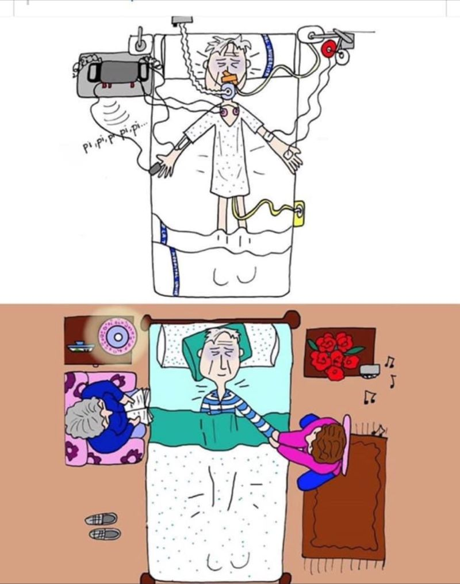

Compare
A.
B.

Slide 13

Some people think “I’ll do that someday, not now though. I have time…”
Damar Hamlin, 24 yr old, Buffalo Bills NFL player.
What if he hadn’t recovered…guardianship, possible intervention
by local officials or national social/political groups (think Terri Schiavo). I wonder if his teammates have completed an advance directive now.
“One of my favorite quotes: It’s a blessing to be a blessing,” Hamlin said while accepting the NFLPA’s Alan Page Community Award with his parents by his side. “With that being said, I plan to never take this position for granted and always have an urgent approach to making a difference in the community where I come from and also communities across the world.” ~ Damar Hamlin
The same could be said by you, as Estate Planners. Your job is to be a blessing and to make a difference for your clients and their families. Effective preparation is what you practice every day. Wholistic preparation includes advance care planning.

Slide 14
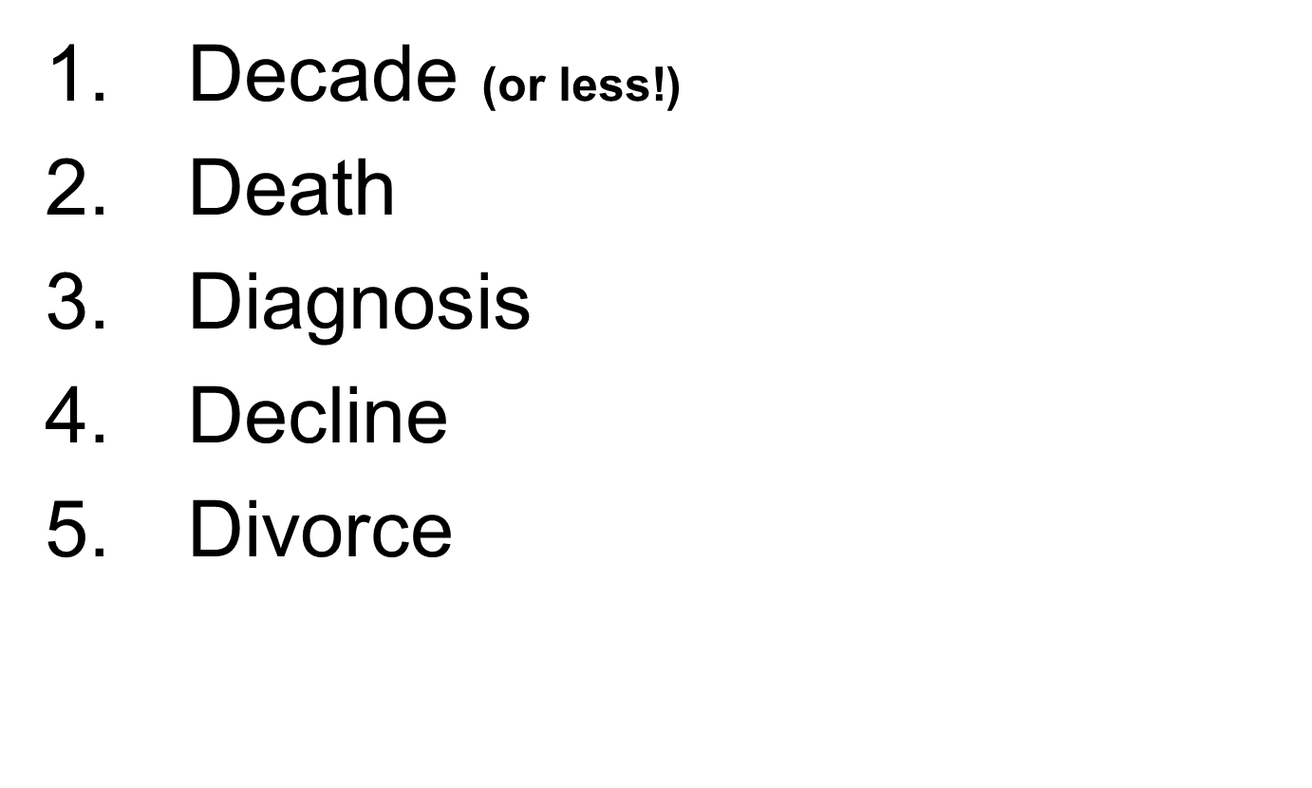
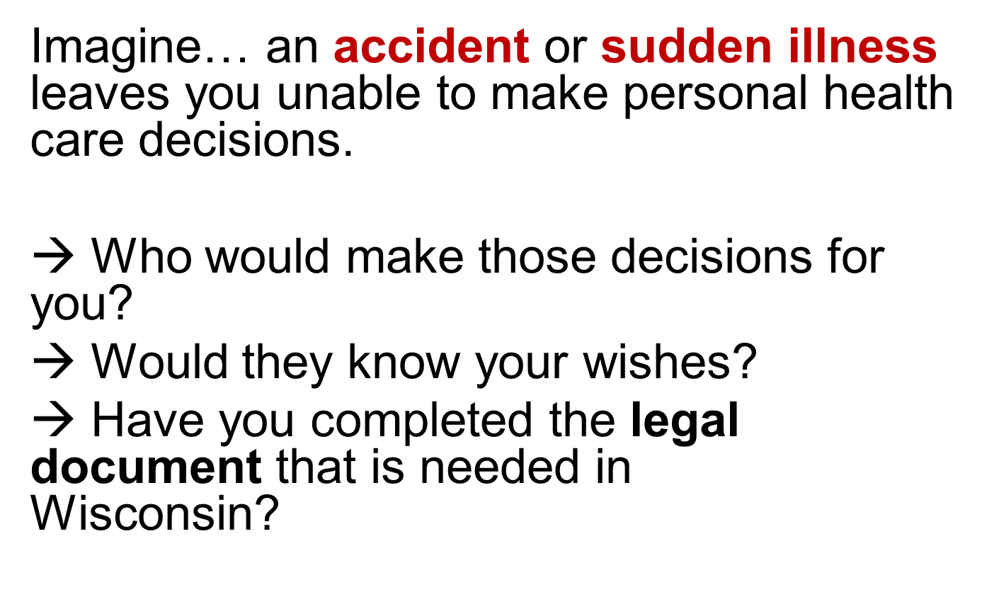
When to revise or create a new POA-HC?
How to start the conversation?

Slide 15


Fox Valley Advance Care Planning Partnership – for more information:
    Dr. Lee Vogel, Mosaic Family Health & Fox Valley Family Medicine Residency Program
Ben Adams, Retired Elder Law Attorney
Bobbie Thompson, MS, FVACPP Executive Director,
(920) 997-8412
Bobbie.Thompson@MosaicFamilyHealth.org
www.FVACPP.org or https://www.fvacpp.org/faqgettingstarted

Slide 16
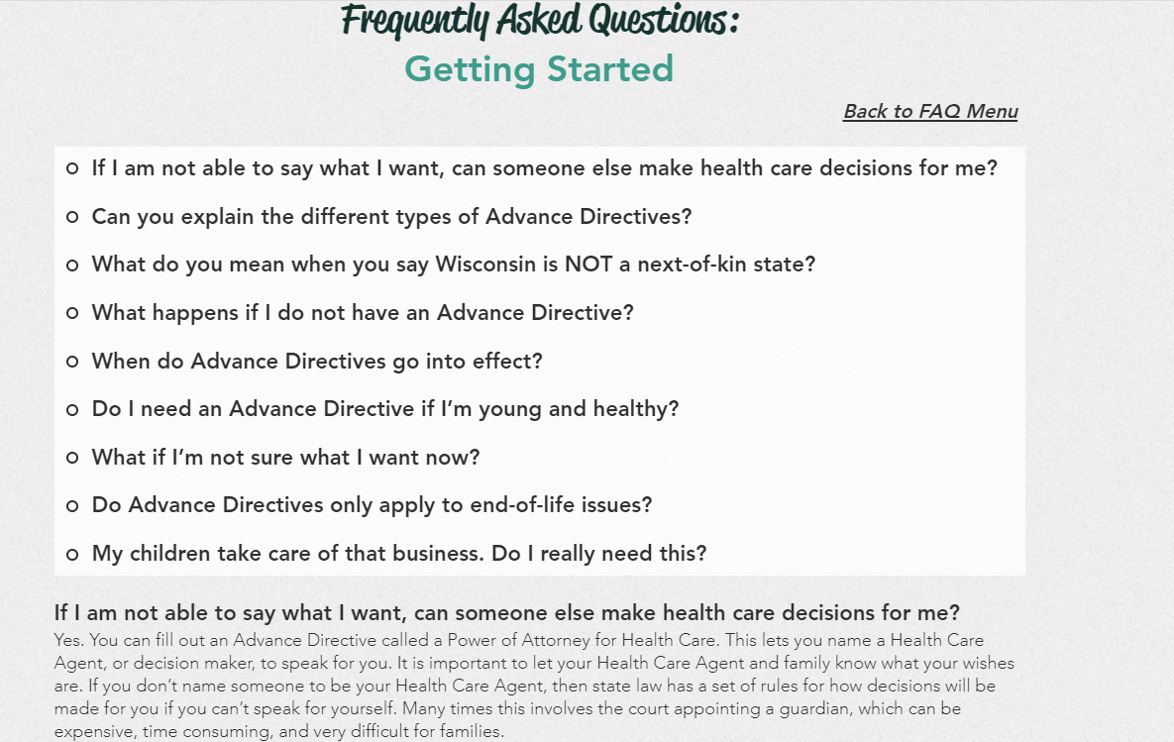
Pages from our website please see www.fvacpp.org/faq for more info

Slide 17
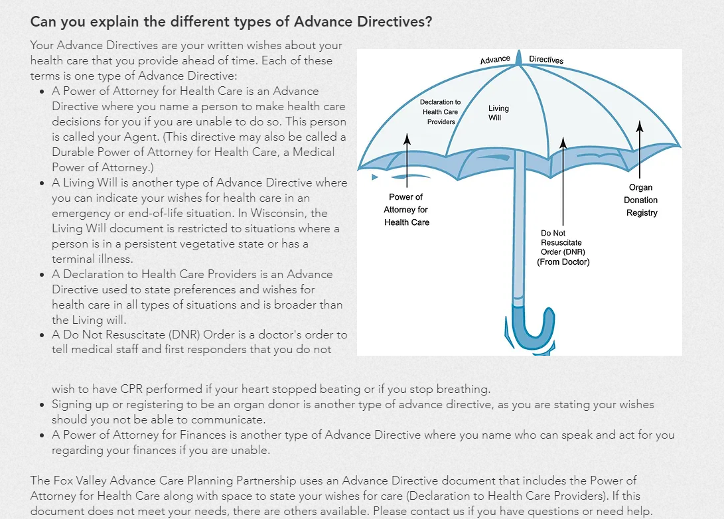
Pages from our website please see www.fvacpp.org/faq for more info

Slide 18
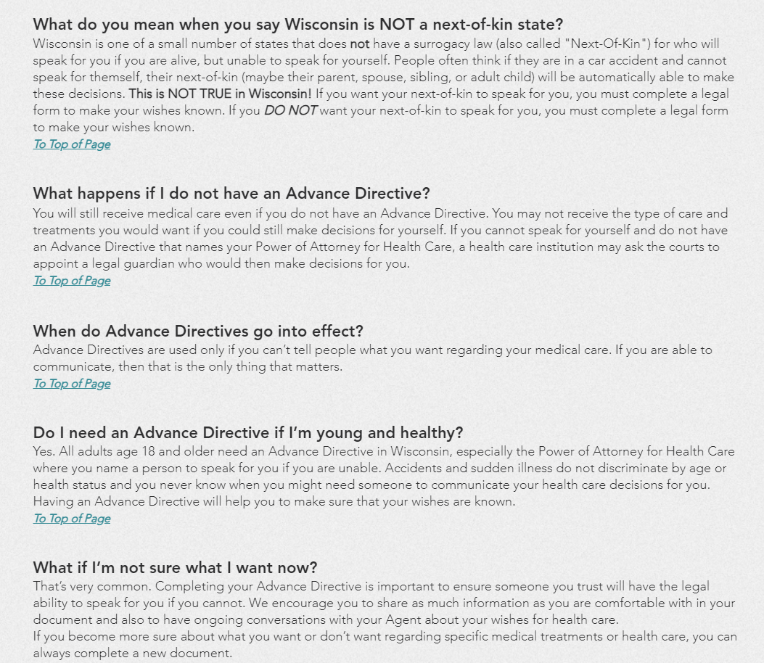
Pages from our website please see www.fvacpp.org/faq for more info

