Slide 1
Getting Ahead of the Biden Administration's Tax Proposals
Drafted October 1, 2021
Robert S. Keebler, CPA/PFS, MST, AEP
Robert.Keebler@KeeblerAndAssociates.com

Slide 2
House Ways & Means Committee Markup:
The Build Back Better Act

Slide 3
2021 Tax Reform – IRS Funding & Compliance
The legislation would appropriate nearly $80 billion to the IRS to improve compliance.
Additional funds would be appropriated to Treasury to supervise the IRS and the Tax Court.
These funds would be available to the through 9/30/2031.
The CBO estimates this would make the IRS’s 2031 budget 90% larger than its current baseline projection and would double staffing.
The CBO estimates 75% of the money would be used for enforcement and this would increase revenue by $200B over 10-years.
The legislation would impose additional reporting requirements for third party network transactions.
https://www.cbo.gov/publication/57444

Slide 4
2021 Tax Reform – IRS Funding & Compliance
The legislation would also impose limitations on pass-through deductions for conservation easements to curb these syndicated transactions being used as tax shelters.
These new rules would apply after 12/23/2016 generally.
Or, in the case of certified historic structures after 12/31/18.

Slide 5
2021 Tax Reform – Individuals
The 39.6% rate is restored:
The 20% capital gains rate increases to 25%
Using 2021 figures, except
for the new 35%,
39.6%, and 25% thresholds.
New rate applies
The date the
bill is introduced.

Slide 6
2021 Tax Reform – Individuals
3.8% Net Investment Income Tax (NIIT) expansion
Expands the NIIT to cover income derived in the ordinary course of a trade or business for high income taxpayers
Does not apply to income on which FICA is already imposed
Applies after 12/31/21

Slide 7
2021 Tax Reform – Individuals
New Section 199A Limitation
Imposes a maximum allowable deduction - I.E. A CAP ON THE AMOUNT CLAIMED
Applies after 12/31/21

Slide 8
2021 Tax Reform – Individuals
Excess Business Loss Limitation
Section 461(l) limits pass-through business net losses which can offset non-business income to $250,000 (or $500,000 MFJ)
This was added by the TCJA and set to sunset in 2025 (note, the CARES Act modified the effective date)
This legislation would permanently apply the limitation beyond 2025

Slide 9
2021 Tax Reform – Individuals
New High Income Taxpayer Surcharge
A surcharge equal to 3% of excessive Modified AGI
The AGI threshold is $5,000,000 generally ($2,500,000 MFS)
The AGI threshold is $100,000 for trusts & estates
Modifications to AGI include a reduction for investment interest
+
+
=
39.6%
3.8%
3%
46.4%

Slide 10
2021 Tax Reform – Individuals, Trusts & Estates
Termination of the Temporary Increase in the Unified Credit
Resets the estate tax exemption to $5,000,000 in 2010 dollars
In 2022, the exemption will therefore be approximately: $6,000,000
The exemption change will be effective to deaths, GST transfers, and gifts made after December 31, 2021

Slide 11
Estate & GST Taxes
Review of Current Situation
Recall:
The TCJA doubled the Basic Exclusion Amount and GST exemption from 2018-2025 ($10,000,000 in 2011 dollars)
In 2026 the exemption is set to revert to pre-TCJA law (5,000,000 in 2011 dollars)
This legislation will accelerate sunset to 2022
POTENTIAL
“USE-IT-OR-LOSE-IT”
OPPORTUNITY

Slide 12
Estate & Gift Taxes
Exemption Reduction Math – “Use It or Lose It”
Old Exemption
$5,850,000
2021 gifts use this portion of the exemption first.
2021 Estate
Tax Exemption
$11,700,000
2021 gifts use this portion of the exemption second.
Lost if not used before the law changes.
2018 Exemption Increase
$5,850,000

Slide 13
2021 Tax Reform – Individuals, Trusts & Estates
2032A Special Valuation reduction increase:
2032A allows a taxpayer to value property used in a family farm or business based on its current use, rather than its highest and best use;
The amount a valuation can be reduced has been frozen at $750,000 for many years.
The legislation would increase the allowable reduction to $11,700,000 and index it for inflation.
The change would apply to deaths after 12/31/21.

Slide 14
2021 Tax Reform – Individuals, Trusts & Estates
Grantor Trusts
The legislation would add Section 2901, to force grantor trusts to be included in the taxable estate.
The legislation would also add Section 1062, which would eliminate non-taxable IDGT sales (and even GRATs).
These changes will apply to trusts created on or after the date of enactment and transfers on or after the date of enactment to pre-existing trusts.
Existing trusts will be grandfathered and there may be a short window of opportunity capture significant future tax benefits.

Slide 15
Grantor Trusts – Sec. 2901
Assets in grantor trusts are included in the grantor’s estate (except grandfathered ones).
Distributions from grantor trusts during the life of the deemed owner are gifts.
The assets of a grantor trust are deemed to be a gift if the grantor trust status is “turned off.”
However, the bill provides an adjustment for taxable gifts as to avoid double inclusion.
IDGT
GRAT

Slide 16
IDGT Sales – Sec. 1062
Deemed ownership disregarded in determining whether a transfer is a sale or exchange:
Exception for fully revocable trusts
Deemed owners expanded to related parties for the purposes of new Section 1062
IDGT

Slide 17
2021 Tax Reform – Individuals, Trusts & Estates
Valuation Rules:
The legislation would amend Section 2031 to eliminate valuation adjustments for non-business assets.
This is similar to a proposal from Senator Sanders earlier this term.
This provision would apply to transfers after the date of enactment.

Slide 18
Valuation Rules – In General
Appraisals commonly consider valuation adjustments for:
Marketability
Minority interests
Blockage
Taxes on Built-in Gain

Slide 19
Valuation Rules – New Section 2031(d)
New General Valuation Rules
The “Non-business” assets of an entity transferred are valued as if the asset were transferred directly.
Non-business assets means any asset not used in the active conduct of a trade or business.
Certain “Passive assets” can be treated as business assets if used in the active conduct of a trade or business.

Slide 20
Valuation Rules – New Section 2031(d)
“Non-Business Assets:”
Held for the production or collection of income, and
Not used in the active conduct of a trade or business.
Certain “Passive Assets” can be treated as business assets if used in the active conduct of a trade or business:
Certain hedges
Real property trades or business in which the transferor materially participates
Additional exception for “reasonably required” working capital.

Slide 21
Valuation Rules – New Section 2031(d)
Look-thru rule:
Designed to prevent any discount for non-business assets held in a lower-tier entity
10% ownership interest threshold
The upper-tier entity is treated as if directly owning its ratable share of the lower-tier entity’s assets

Slide 22
Valuation Rules
Example
 | Before Enactment | After Enactment
Gross Value | $10,000,000 | $10,000,000
Marketability Adjustment | (2,000,000) | (0)
Minority Interest Adjustment | (1,200,000) | (0)
Net Value | $6,800,000 | $10,000,000
Estate Tax @ 40% | $2,720,000 | $4,000,000

Slide 23
Valuation Rules
Example/Summary
Operation | Trade or Business | Owned by | Marketability Discount | Subtract out Non-Business Assets
Automobile Dealership | Yes | Family Members | Yes | Yes
Apartment Building – Material Participation | Yes | Family Members | Yes | Yes
Triple Net Lease Real Estate – No Material Participation | No | Family Members | No | N/A – entire enterprise treated as a non-business asset

Slide 24
2021 Tax Reform – Retirement Plan Limits
Contribution Limits for Taxpayers with Large Balances – New Sec. 409B
Annual additions (any contributions) are prohibited if the taxpayer has an excessive balance, effective after 12/31/21.
However, the limit would only apply to taxpayers with AGI in excess of the following thresholds:
All figures would be
adjusted annually
for inflation.

Slide 25
2021 Tax Reform – Retirement Plan Limits
Contribution Limits for Taxpayers with Large Balances – New Sec. 409B
This applies to a tax year when total defined contribution plan and IRA accumulations exceeds $10,000,000 (the applicable threshold) on 12/31 of the prior year.
Rollovers would not be considered an addition
Accounts acquired by death or divorce or separation would not be considered an addition
Additional reporting requirements imposed on accounts in excess of $2,500,000
Section 4973(i) is added to impose a 6% excise tax

Slide 26
2021 Tax Reform – Retirement Plan Limits
Increased RMD for High-income Taxpayers with Large Balances – New Sec. 4971(e)
An additional minimum distribution will be imposed on taxpayer’s with large retirement account balances after 12/31/21.
It will apply when total defined contribution plan and IRA accumulations exceed $10,000,000 on 12/31 of the prior year.
However, these limits would only apply to high-income taxpayers:

Slide 27
2021 Tax Reform – Retirement Plan Limits
Increased RMD for High-income Taxpayers with Large Balances – New Sec. 4971(e):
50% Distribution Rule: The new additional minimum distribution would generally be 50% of the amount total accumulations exceed $10M (“the applicable dollar amount”)
100% Distribution Rule: In addition, to the extent that the combined balance amount in traditional IRAs, Roth IRAs and defined contribution plans exceeds $20 million, that excess is required to be distributed from Roth IRAs and Roth designated accounts in defined contribution plans up to the lesser of (1) the amount needed to bring the total balance in all accounts down to $20 million or (2) the aggregate balance in the Roth IRAs and designated Roth accounts in defined contribution plans.

Slide 28
2021 Tax Reform – Retirement Plan Limits
Roth Conversion Income Limitations – Amends Section 408A(e)
Before 2010, those with income in excess of $100,000 were prohibited from making Roth Conversions.
Currently, income limitations remain for Roth contributions; however “backdoor” conversions easily end-run these limits.
The bill would eliminate Roth conversions for taxpayers with income in excess of the following thresholds:
Note, the proposed effective date
for this new limitation is
2032.

Slide 29
2021 Tax Reform – Retirement Plan Limits
New Prohibited Investments
The legislation would prohibit an IRA from holding investments which are only offered to accredited investors (i.e. nonregistered securities).
This is an attempt at rough justice from Congress in order to prohibit investments that taxpayers use to accumulate huge sums in their retirement accounts.
IRAs holding such assets after the effective date would deemed to be distributed; however, a 2-year transition period is provided.
The effective date would be 12/31/21.

Slide 30
2021 Tax Reform – Retirement Plan Limits
IRA Non-Compliance Statute of Limitations
Currently, the SOL for valuation related reporting and PTs is 3 years.
The legislation would extend this to 6 years.
This would apply to taxes to which the current 3-year period ends 12/31/21.

Slide 31
2021 Tax Reform – Retirement Plan Limits
IRA Self-Dealing
Currently, an IRA cannot invest in a business entity in which the IRA owner holds a 50% or greater interest.
The legislation reduce this threshold to 10% for investments which are not tradable on an established securities market.
This limit would include direct and indirect interests.
Further, the legislation would change this limit to an IRA requirement (it is currently a PT).
This change would apply after 12/31/21, with a 2-year transition period for IRAs already holding such assets.

Slide 32
2021 Tax Reform – Retirement Plan Limits
Disqualified Persons
The bill would clarify that for the purposes of the PT rules, the IRA owner and beneficiary of an “inherited” IRA is always a disqualified person.
This would apply to transactions after 12/31/21.

Slide 33
2021 Tax Reform – Corporate & International
Graduated corporate rate structure to replace the 21% flat rate:
New international interest expense limits, new outbound international provisions, new inbound international provisions, BEAT modifications, and various other business tax provisions.

Slide 34
Sensible Taxation and Equity Promotion (STEP) Act of 2021
A Detailed Review of Introduced Legislation

Slide 35
Basic Proposal
Realization of gains at gift – Proposed New IRC § 1261
Realization of gains at death – Proposed New IRC § 1261
Repeal of carryover basis for gifts – IRC § 1015 modification
Repeal of the adjustment of basis to fair market value at death (the step-up) – IRC § 1014 modification

Slide 36
Detailed Proposals
House Bill
Introduced by Mr. Bill Pascrell (D., Nj.)
2022 effective date
Senate Bill
Sensible Taxation and Equity Promotion (STEP) Act of 2021
Introduced by Mr. Chris Van Hollen (D., Md.)
Retroactive 2021 effective date
President’s Budget (Green Book)
2022 effective date
Very similar proposals

Slide 37
Core Statutory Language
Senate Language:
IN GENERAL.—Any property which is transferred by gift, in trust, or upon death shall be treated as sold for its fair market value to the transferee on the date of such gift, death, or transfer.

Slide 38
Core Statutory Language
House Language:
IN GENERAL.—Any property which is transferred by gift or at death shall be treated as sold for its fair market value on the date of such gift or death.

Slide 39
Detailed Proposals
Special Rules for Grantor Trusts – Common to Both Bills
No realization when assets are transferred to a grantor trust
However, a realization event occurs:
If the trust is included in the grantor’s estate
When distributions are made to beneficiaries
If grantor trust status is “turned off”

Slide 40
Exceptions to Forced Recognition Under Proposed New § 1261
Spouses
Certain grantor trusts (e.g. living trust)
Gifts & bequests to charity
Tangible personal property not used in a trade or business or for the production of income
These exceptions are shared with all three proposals
(with some variation in the details)
Sensible Taxation and Equity Promotion (STEP) Act of 2021

Slide 41
Exceptions to Forced Recognition Under New § 139I
$100,000 gain exclusion for gifts during life
$1,000,000 gain exclusion for gifts at death
Mom gifts $250,000 of stock to daughter with a basis of $120,000. $30,000 of taxable income is recognized ($250,000 - $120,000 - $100,000)
Mom gifts $2,500,000 of stock to daughter with a basis of $1,200,000. $300,000 of taxable income is recognized ($2,500,000 - $1,200,000 - $1,000,000)
Sensible Taxation and Equity Promotion (STEP) Act of 2021

Slide 42
Exceptions to Forced Recognition
The President’s Budget additionally provides:
The $1,000,000 exclusion at death is reduced by any gifts which use the lifetime exclusion
The $1,000,000 exclusion is portable between spouses
Department of the Treasury (May 2021), General Explanations of the Administration’s Fiscal Year 2022 Revenue Proposals (i.e. the Green Book), page 62-64

Slide 43
Detailed Proposals
Special Rules for Non-Grantor Trusts – Common to Both Bills (the budget is unclear regarding distributions)
Recognition event upon transfer to trust
Recognition event upon distributions from trust
Tax
Tax
Gifts
TRUST
Distributions

Slide 44
Detailed Proposals
Periodic deemed recognition event for Non-Grantor Trusts – Common to Both Bills & the President’s Budget
House Bill
Deemed recognition event for any property continuously held in trust after a period of 30 years
Any property continuously held in trust for more than 30 years on January 1, 2022 shall ne treated as transferred
Senate Bill
Deemed recognition event for all property held in trust every 21 years
All property held in trust on since December 31, 2005 on December 31, 2026 (21 years)
President’s Budget
Deemed recognition event for all property held in trust every 90 years
All property held in trust on since January 1, 1940; first recognition date of December 31, 2030

Slide 45
Forced Recognition @ Gift
Non-Grantor Trust
Grantor
Trust
Charity
Natural
Person
Recipient
Is the recipient the spouse?
Will the trust be included in the grantor’s estate?
No
Yes
Yes
No
Forced Recognition
@ Gift
NO Forced Recognition
@ Gift
Tax Treatment
The STEP Act of 2021, Proposed New IRC 1261

Slide 46
Forced Recognition @ Death
Recipient
Non-Grantor Trust
Charity
Natural
Person
QTIP Election or Life Estate with a POA for the Spouse?
Is the recipient the spouse?
No
No
Yes
Forced Recognition
@ Death
Yes
NO Forced Recognition
@ Death
Tax Treatment
The STEP Act of 2021, Proposed New IRC 1261

Slide 47
Income Tax Planning Ideas
Gain Harvesting
Advanced Security Strategies
Charitable Remainder Trusts*
Charitable Lead Trusts*
Donating Capital Gain Property
Installment Sales
Opportunity Zones
Section 1031 Exchanges
*The President’s budget proposes a forced recognition event when appreciated assets are transferred to a split-interest trust.

Slide 48
APPENDIX
Income Tax Planning Ideas
For the STEP Act

Slide 49
Gain Harvesting Overview
Strategy:
Taxpayer expects to be in a higher tax bracket in the future
Sell assets and pay
Repurchase same or similar assets
Effect: Shifts recognition of capital gain from a higher future bracket tax year a the lower bracket

Slide 50
Gain Harvesting Tradeoffs
On the surface, it appears that taxpayers should always harvest gains
However, harvesting gains introduces a tradeoff between lower tax rates versus the loss of tax deferral
Tax is paid at a lower rate, but it is paid sooner
Need to determine a crossover point at which selling sooner makes more sense; A way to conceptualize this would be to use a return on investment (ROI) approach

Slide 51
Gain Harvesting Basic Example

Slide 52
President Biden Tax Policy Proposals
Proposal to eliminate the preferential rate for long-term capital gains and qualified dividends on income over $1,000,000
Most significant proposal & a fundamental shift
Basically an increase from 20% to 39.6%
Expect many people to sell assets if there’s time to front-run this
President Biden’s Budget Proposes a Retroactive Effective Date of 4/28/20

Slide 53
Married Filing Jointly
Capital Gain & Qualified Dividend Rates
2017
2021
2022 ?

Slide 54
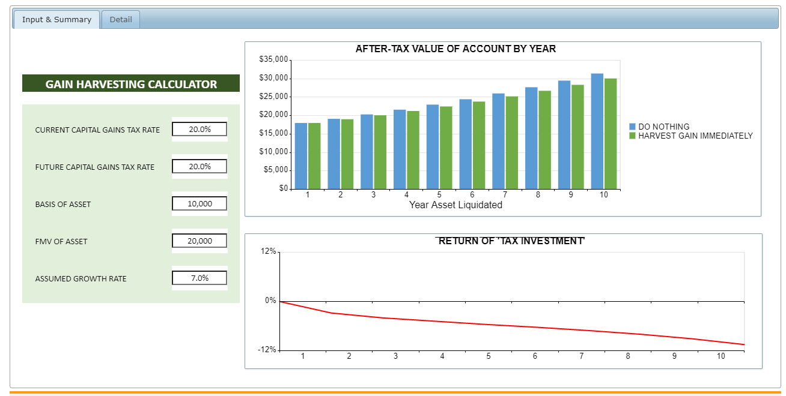

Slide 55
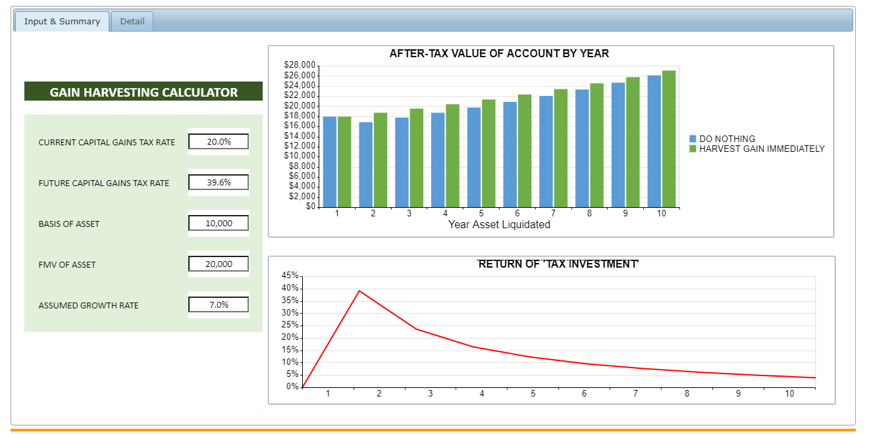

Slide 57
Charitable Remainder Trusts Definition
A Charitable Remainder Trust (CRT) is a split interest trust consisting of an income interest and a remainder interest.
During the term of the trust, the income interest is usually paid out to the donor (or some other named beneficiary).
At the end of the trust term, the remainder (whatever is left in the trust) is paid to the charity or charities that have been designated in the trust document.

Slide 58
Charitable Remainder Trusts Two Types of CRTs
Charitable Remainder Annuity Trust (CRAT)
The beneficiaries receive a stated amount of the initial trust assets each year
The amount received is established at the beginning of the trust and will not change during the term of the trust regardless of investment performance (unless inadequate investment performance causes the trust to run out of assets)
Charitable Remainder Unitrust (CRUT)
Income beneficiaries receive a stated percentage of the trust’s assets each year.
The distribution will vary from year to year depending on the investment performance of the trust assets and the amount withdrawn

Slide 59
Charitable Remainder Trusts Purposes
Charitable remainder trusts can be used to reduce or avoid surtax and incremental capital gains tax by smoothing out income
CRTs are particularly useful when a taxpayer has a large capital gain that pushes income above the applicable threshold amount (ATA)
Before explaining how the planning works, it will be helpful to look at some background information

Slide 60
Charitable Remainder Trusts Taxation
The donor will NOT realize gain or loss when property is transferred to the trust under current law*
However, the grantor may be required to recognize gain if:
Property transferred is subject to indebtedness that exceeds grantor basis
Grantor receives property from the trust in exchange for the transfer to the trust.
The donor will NOT realize gain or loss if and when the transferred assets are subsequently sold by the trustee of the CRT
*The President’s budget proposes a forced recognition event when appreciated assets are transferred to a split-interest trust.

Slide 61
Charitable Remainder Trusts Taxation
The character of income received by the recipient is subject to and controlled by the tier rules of IRC §664(b)
First, distributions are taxed as ordinary income
Second, distributions are taxed as capital gains
Third, distributions are taxed as tax-exempt income (e.g. municipal bond income)
Finally, distributions are assumed to be the non-taxable return of principal
CRTs are not subject to the 3.8% surtax
However, see Reg. Section 1.1411-3(d) for special rules on how the distributions of NII are taxed to beneficiaries

Slide 62
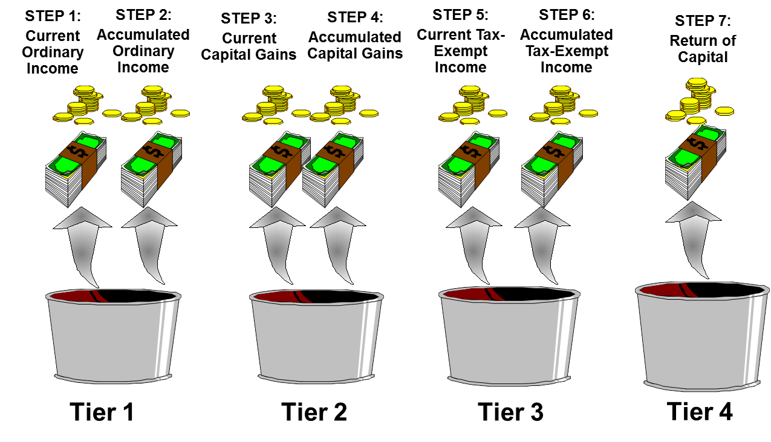
Charitable Remainder Trusts Taxation

Slide 63
Charitable Remainder Trusts Substantial Sale Strategy
Substantial Sale CRT
CRT structured to eliminate, reduce or defer capital gain taxation
Strategy:
Taxpayer has a large capital gain
Taxpayer contributes the appreciated asset(s) to a CRT
The CRT sells without recognizing gain
The gain is recognized as annuity (or unitrust) payments are made
This defers the tax liability for years and or reduces the total tax liability by avoiding higher income and a higher rate
The worst case scenario is tax deferral, while the best case scenario is tax rate arbitrage

Slide 64
Charitable Remainder Trusts Substantial Sale Strategy
Transfer of highly
appreciated assets
Donor
(Income Beneficiary)
CRT
Annual (or more frequent) payments for life (or a term of years)
At the end of the trust term, the charity receives the residual assets held in the trust
Donor receives an immediate income tax deduction for present value of the remainder interest (must be at least 10% of the value of the assets originally contributed)
Public Charity
(Remainder Beneficiary)

Slide 65
Installment Sales Overview
An installment sale is a type of sale in which the seller sells an asset to another person in exchange for a promissory note paid over time.
If executed correctly, the taxable gain recognized by the seller will be deferred until payments are made on the principal of the note. IRC § 453.

Slide 66
Installment Sale Overview
IRC § 453 allowed for deferral of taxation on Installment Sales
$5,000,000 annual limitation
$10,000,000 annual limitation for married couple
Gain is generally deferred until payment occurs
Depreciation recapture provisions – IRC § 453(i)

Slide 67
Installment Sale Increase in Basis
Sale from taxpayer to a non-grantor trust or a child receives a basis increase
Basis will equal the purchase price

Slide 68
Installment Sale Two Planning Ideas
Two-Year Installment Sale
Long-term Installment Sale

Slide 69
Two-Year Installment Sale Two-Year Rule
IRC § 453(e)(2) provides a sale by a related party within two years results in realization of the original deferral
Therefore, the original buyer must wait at least 2 years and one day to sell the asset to a third-party
No realization of the original gain if the sale is at least two years and one day later

Slide 70
Two-Year Installment Sale Strategy
Strategy
Parent has an asset with a large capital gain
Parent sells it to a nongrantor trust for the benefit of his or her children and takes back an installment note
The trust receives a stepped-up basis in the asset
Two years and one day later the trust sells the asset, recognizing little, if any, gain
Trust makes payments to Parent who spreads the gain out over the period of the installment note

Slide 71
Two-Year Installment Sale Benefits
Benefits
Income smoothing: Avoids the higher tax brackets & NIIT
Timing benefit: Children cash in the full appreciated value of the asset before most the gain is recognized by the parents.

Slide 72
Installment Sale Longer Term Sales
Two-years is the minimum for an intra-family installment sale & re-sale to be effective
A taxable sale can also be effective if the family intends to retain the asset
Longer term intrafamily sales can:
Spread gain over many years to defer & reduce tax
Step-up basis to avoid a sudden recognition event and to re-start depreciation
Provide an income stream to the seller
Allow the sale to cash-flow
Shift any above-market appreciation out of a taxable estate

Slide 73
Installment Sale Intra-family Sale Strategy
Parent
Sale of highly-appreciated asset
Non-Grantor
Trust
Promissory note paid over a period of years
Taxable gain is deferred until payments on principal are made

Slide 74
Installment Sale Election Out
Section 453(d) allows the taxpayer to elect out of installment treatment
In other words, the client could sell an asset in exchange for an installment note yet could pay the tax in the year of the sale rather than as the proceeds of the sale are received
The election must be made before the tax return is filed, or in other words, as late as 10/15/22 for a 2021 sale
The “election out” could be used to accelerate income into a low tax year

Slide 75
Mathematics of Roth IRA Conversions
In simplest terms, a traditional IRA will produce the same after-tax result as a Roth IRA provided that:
The annual growth rates are the same.
The tax rate in the conversion year is the same as the tax rate during the withdrawal years (i.e., A x B x C = D; A x C x B = D).

Slide 76
Mathematics of Roth IRA Conversions

Slide 77
Mathematics of Roth IRA Conversions
Critical decision factors:
Tax rate differential (year of conversion vs. withdrawal years)
Use of “outside funds” to pay the income tax liability
Need for IRA funds to meet annual living expenses
No RMDs
Tax-free post-mortem distributions
Time horizon
Estate tax considerations
Ten Year “Roth Coast” period

Slide 78
Mathematics of Roth IRA Conversions
Deferral
Beyond
the RBD
Using Outside Funds
to Pay Conversion Tax
Tax Rate Arbitrage
10-Year Post-mortem Tax-free Growth
“Roth Coast Period”

Slide 79
Mathematics of Roth IRA Conversions
The key to successful Roth IRA conversions is usually to avoid large jumps in brackets (e.g., converting at a 32% rate when distributions will likely be subject to a 24% rate will often be ineffective).
Although brackets are the primary consideration, there are others: capital gains, AMT, NIIT, 199A, etc.

Slide 80
Mathematics of Roth IRA Conversions
37% tax bracket
35% tax bracket
Example of a possible “optimum” conversion amount
32% tax bracket
Current taxable income
24% tax bracket
22% tax bracket
12% tax bracket
10% tax bracket

Slide 81
Mathematics of Roth IRA Conversions
39.6% tax bracket
35% tax bracket
Target Roth IRA conversion range for most “middle income” taxpayers
33% tax bracket
37% tax bracket
28% tax bracket
35% tax bracket
25% tax bracket
32% tax bracket
15% tax bracket
24% tax bracket
10% tax bracket
22% tax bracket
12% tax bracket
Black steps = Current law
Red steps = Pre-TCJA (which the tax law reverts to in 2026)
10% tax bracket

Slide 82
Mathematics of Roth IRA Conversions
Tactical considerations:
Unused charitable contribution carryovers
Current year ordinary losses
Net Operating Loss (NOL) carryovers
Alternative Minimum Tax (AMT) credits
Other credit carryovers
Strategic considerations
Opportunistic considerations

Slide 83
Conclusion

