Slide 1

Yearend Planning – A Multi-Disciplinary Approach
November 9, 2023
Butte des Morts Country Club

Slide 2
Presenter Panel
Ryan Laughlin – Hawkins Ash
Matthew Brehmer – Brehmer Law LLC
Grace Anderson – Johnson Financial Group
Michelle Lippart Hardwick – Community Foundation for the Fox Valley Region, Inc.
Nick Sattler – Hawkins Ash
Brenton Teeling – Legacy Private Trust Company

Slide 3
Common Themes
Collaboration Amongst all Professionals
Short-Term Actions – But Long-Term Focus
Retirement Related Planning
Estate & Gift Tax Ideas - Gifting to Family
Income and Estate Ideas – Gifting to Charity
Income Tax Other
Tax Legislation – Pending, SECURE Act(s), Other

Slide 4
Retirement Planning & Investment Considerations
Market overview & investment allocation
What’s Changed? Income, key ages, family dynamics, etc.
Roth Conversions
Opportunities to “max” 2023 contribution limits
Social Security strategies
Required Beginning Date & RMDs
Notes:
I think this is mainly Grace’s area with Brenton chiming in. Nick should chime in when income tax issues are discussed or need clarification.

Slide 5
Case Study 1 –
Sally 59 and Sam 60 will both receive significant bonuses at the end of 2023. They have not been maximizing their elective deferrals to their respective 401(k) plans because of tight finances during the year. What might you advise them to consider?
Case Study 2 –
Sam turned 63 in October of 2023. His first RMD (at age 75) is projected to be $65,000. He retired in March of 2023 and has been living off cash savings for most of the year. He is considering a Roth conversion and an IRA distribution before 2024. He is a widower, and has two adult children named beneficiaries. What would you advise him to consider?
Notes:
If you want to personalize the Case Study with something you experienced yourself, feel free to do so. Just keep the verbiage short, so as not to add too many slides.

Slide 6
Case Study 3 –
Sam, age 74, died in April 2023 before he took his RMD. Sally, his surviving widow is 57 and was named as his designated beneficiary. What are her options? What if she needs distributions from the IRA to live on?

Slide 7
Estate Planning Ideas
Annual Exclusion Gifting –
  $17,000 per person (expected to be $18,000 in 2024)
    Married couples, filing jointly -- gift splitting
Direct Payment of Tuition and Medical Expenses –
  Must be direct
  Separate from annual exclusion amount
Options for Cash Gifting –
  What is the purpose? How much flexibility is desired? What amounts (and expense)?
  Outright
  ILIT gifting for premium payments
  529 accounts
  UTMA accounts
  Trusts
    2503(c) Trusts
    Crummey Trusts
Notes:
Brenton to lead
Ryan, Matt’s area with Brenton maybe chiming in – this slide and the next

Slide 8
When is a gift complete?
  Best practice (especially for large gifts) is to avoid these rules and gift early!
  Be aware of different rules for gifts to individuals v. charitable organizations
    Individuals – unconditional relinquishment of control of gifted property
      Checks – delivery and deposited/cashed by recipient
      Securities – actually transferred (via broker or endorsed & delivered stock certificate)

Slide 9
Karl and Kate
Case Study 1 –
Karl and Kate are grandparents to two newly born grandchildren, one each to daughter Kristen and son Ken. What are their options for making annual exclusion gifts to them in 2023 and 2024?
Case Study 2 –
Joe has a taxable estate. He is not married and has no children but has several highly-adored nieces and nephews. What options are available to him benefit his nieces and nephews and reduce his potential estate tax liability?
Notes:
If you want to personalize the Case Study with something you experienced yourself, feel free to do so. Just keep the verbiage short, so as not to add too many slides.

Slide 10
Options for Business Interest Gifting –
  Outright or to Trusts
  Bunching (valuation purposes)
  Coordination with trustees (when drafting and administering)

Slide 11
Case Study 1 –
Kate owns ABC Entertainment, LLC worth 2.5 million. Kate and Karl have 5 children (who all work in the business) and 10 grandchildren (all minors). They want to start gifting her interest in the LLC to her children and grandchildren a little at a time. They have come to you on October 1, 2033. What is your advice? What are the steps they would need to take to affect the gifts?
Notes:
If you want to personalize the Case Study with something you experienced yourself, feel free to do so. Just keep the verbiage short, so as not to add too many slides.

Slide 12
Use Gift and GST Exclusions - $12,920,000 in 2023 (2024 estimated to be $13,660,000)
  Consider Sunset of Limitations at end of 2025
  Cash or Securities - Outright or to Trusts
  Business Interests – Outright or in Trusts
  Trusts - IDGTs, SLATs, QPRTs, CRTs
  Forgive Notes
  Net Gifts
Notes:
Ryan and Matt

Slide 13
  Use Gift and GST Exclusions - Continued
  Life Insurance - ILITS
  Trust Document Development – Grantor vs Non-grantor
  Valuation of Assets
  Consider Interest Rate Environment on Techniques
  Rev Rul 80-58 - Doctrine of Recission

Slide 14
Case study 1 –
Colt and Cassie are worth $12 MM. They have used $8.0 MM each of their lifetime gift exclusion through 2022. They already transferred 52% of their business to a Trust for their 4 children. They have not planned for their 8 grandchildren yet. They feel like they cannot afford to part with anymore of their business because of cash flow needs. They have a home and a lake cottage. What can they do to take advantage of their remaining and increasing lifetime exclusion.
Notes:
If you want to personalize the Case Study with something you experienced yourself, feel free to do so. Just keep the verbiage short, so as not to add too many slides.

Slide 15
Review Estate Plan for:
Changes in Assets
Inherited Assets
Major or Life Changes (birth, death, move)
Goals for distribution change
Children have reached age 18
Review Beneficiary Designations
Notes:
Matt’s area

Slide 16
Gifting to Charity – Income and Estate Ideas
Cash and/or securities
Outright or to DAF (other type fund)
Bunching of Donations
Qualified Charitable Distribution (QCD)
Charitable Remainder Trust (CRT) or Charitable Gift Annuity (CGA)
Year-end Deadlines – When is gift complete
  Stock, Check, Credit Card; IRA – QCD,
  Illiquid Asset (valuation)
Notes:
Michelle to lead discussion with Grace, Brenton and Nick chiming in

Slide 17
Year-End Giving - Key Dates for 2023
2023 Dates | Gift Type | Details
Friday, 12/8 | Securities | Recommend initiating by this date.
Friday, 12/8 | Non-cash assets | Recommend initiating by this date – or sooner.
Friday, 12/29 | Securities | Must be received by this date. (This is the last business day of 2023)
Friday, 12/29 | Wire transfer | Must be received by this date. (This is the last business day of 2023)
Saturday, 12/30 | Checks | Must be postmarked by this date. (Caution: The IRS only recognizes the USPS postmark date. They do not recognize FedEx, UPS, etc.)
Sunday, 12/31 | IRA | Must leave account by this date. (Caution: Checks written from donors against an IRA account must be deposited by 12/31)
Sunday, 12/31 | Online Credit Card | Must be completed online by 11:59 p.m.
Sunday, 12/31 | Non-cash Assets | Must complete transfer by this date.
2023 Dates | Community Foundation deadlines
Wed., 11/15 | Deadline to establish a scholarship that can make awards in 2024.
Friday, 12/15 | Deadline for making grant recommendations through a donor advised fund.
Friday, 12/29 | Deadline to establish a new fund. (This is the last business day of 2023)
Some of the dates above are specific to 2023. If December 31 falls on a weekend, some deadlines will move to the last business day of the month.
Notes:
Year-end Giving – Key Dates by Gift Type (2023)
Note - December 31 falls on a Sunday this year
Charitable Contributions
Check - Postmarked by December 31 (2023 – Dec. 30).
IRS only recognizes USPS date, so best to avoid FedEx, UPS,
Wire transfer – Must be received by December 29
Online Credit Card – Completed online by December 31 (11:59p.m.)
Securities – Must be received by December 29 – recommend initiating by December 8
IRA – Must leave account by December 31
Caution – Checks written from donors against IRA account must be deposited by December 31
Non-cash assets – Transfer to be completed by December 31 – recommend initiating by December 8 (or SOONER)
Grants
Donor Advised Grant Recommendations (CFFVR specific) – December 15
New Funds
New Scholarship Fund for 2024 – November 15
New DAF – December 29

Slide 18
Case Study 1 –
Bill and Brenda inherited stock from Brenda’s parents that has a basis of $50 per share. It is now worth $250 per share. They want to make a charitable donation, worth $100K. They are not sure what organization they wish to benefit? What are their options for making the charitable donation. What steps do they need to take?
Case Study 2 –
Bill and Brenda have not itemized in several years – since the change in the law in 2017 although they give $10K annually to charities. How can they maximize their giving to create some tax benefit.
Notes:
If you want to personalize the Case Study with something you experienced yourself, feel free to do so. Just keep the verbiage short, so as not to add too many slides.

Slide 19
Case Study 3 –
Brenda is retired and has a $1.0 MM IRA. She is living on Social Security and a small pension. She turned 70 on April 1, 2023. She wishes to make a $100K donation to her local Community Foundation. What are her options. What steps should she take.
Case Study 4 –
Bill and Brenda sold their business in 2023 for $10.0 MM – with a gain of $2.5 million. They finally monetized their business and wish to now enjoy the increased income potential. They wish to make a charitable donation to offset some, but not all of their gain. What are their options? What steps do they need to make with each option.
Notes:
If you want to personalize the Case Study with something you experienced yourself, feel free to do so. Just keep the verbiage short, so as not to add too many slides.

Slide 20
Income Tax Other – Individual
Tax Sensitive Investing – Loss Harvesting
Trust Distributions to Lower tax bracket beneficiaries – 65 day distributions
Notes:
Grace
Nick
Brenton
Matt
Ryan

Slide 21
TCJA Sunset at the end of 2025 (not just estate tax bubble).
Tax Rates Increase.
Standard Deductions decrease.
Personal Exemptions return.
Mortgage interest limitations (back to $1M).
Miscellaneous itemized deductions return.
Itemized deduction limitations (PEASE) return.
Child tax credit reverts to $1k/child from $2k; and AGI limit reverts to $200k from $400k.
Qualified business income sunsets!
Return of AMT!
Notes:
Secure 2.0
Roth w/ 529 Plan
Roth SEP
Bonus
Sunset @ the end of 2025
Tax Rate increases
Standard Deduction decreases
Corporate Transparency Act
H S A
$2,500 real estate tax
AGI Limitations with charitable giving.
Trust Tax Planning
1041-T
65 day distribution
WI no safe harbor for estimates
WI qualified Business
US Savings Bonds election- decedent’s final return or individual return.

Slide 22
Other Pending Changes of Significance
Bonus Depreciation Changes.
  2022: 100%.
  2023: 80%.
  2024: 60%.
  2025: 40%.
  2026: 20%.
  2027: 0%.
Sec 179: TCJA permanently increased to $1M with overall placed-in-service cap of 2.5M.
ERC updates.
New Laws in effect for 2023 & 2024
  Secure Act 2.0.
    529 Plans Transfer to Roth IRA.
    New – Roth SEP IRA.
  WI Capital Loss Matches Federal.
Notes:
Secure 2.0
Roth w/ 529 Plan
Roth SEP
Bonus
Sunset @ the end of 2025
Tax Rate increases
Standard Deduction decreases
Corporate Transparency Act
H S A
$2,500 real estate tax
AGI Limitations with charitable giving.
Trust Tax Planning
1041-T
65 day distribution
WI no safe harbor for estimates
WI qualified Business
US Savings Bonds election- decedent’s final return or individual return.

Slide 23
Year-end clean up items:
HSA contributions, including catch up (spouses too).
Property Tax Payments (consider WI credit).
Wages for S-Corp Owners for QBI Deduction.
AGI Limitations for Charitable Giving (be aware of ordering rules).
Consider IRMAA & Taxable Social Security.
US Savings Bond Election, especially for deceased taxpayers.
WI Qualified Business.
Trust Tax Planning:
  65 Day Distributions.
  No Safe Harbor for Estimated Taxes on WI tax return.
  1041-T.

Slide 24
Corporate Transparency Act
The Corporate Transparency Act (CTA), enacted in 2021, was passed to enhance transparency in entity structures and ownership to combat money laundering, tax fraud, and other illicit activities.
Effective starting 1/1/2024

Slide 25
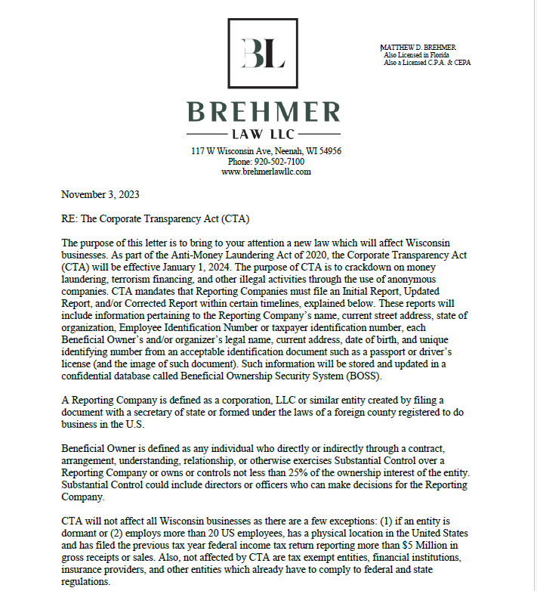

Slide 26
